Slide 1
Scalable Multi-Period Optimal Power Flow for Active Power Distribution Systems or simply, Scalable MP-OPF in ADS
Aryan Ritwajeet Jha
Graduate Research Assistant
Washington State University
Notes:
Remember to hit the reset button to make sure all the page elements react properly.
There are 20 different layouts that you can choose from.

Slide 2
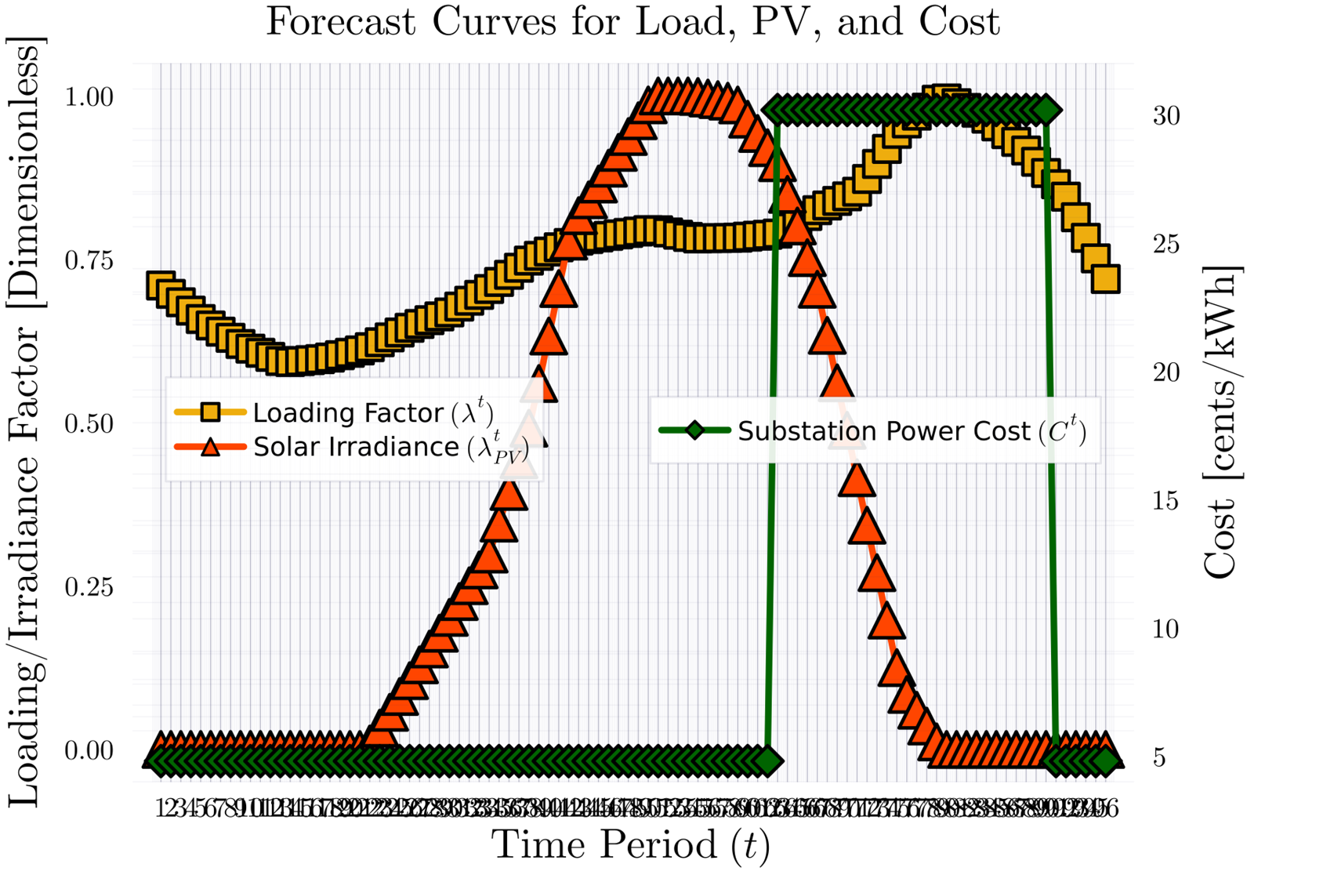
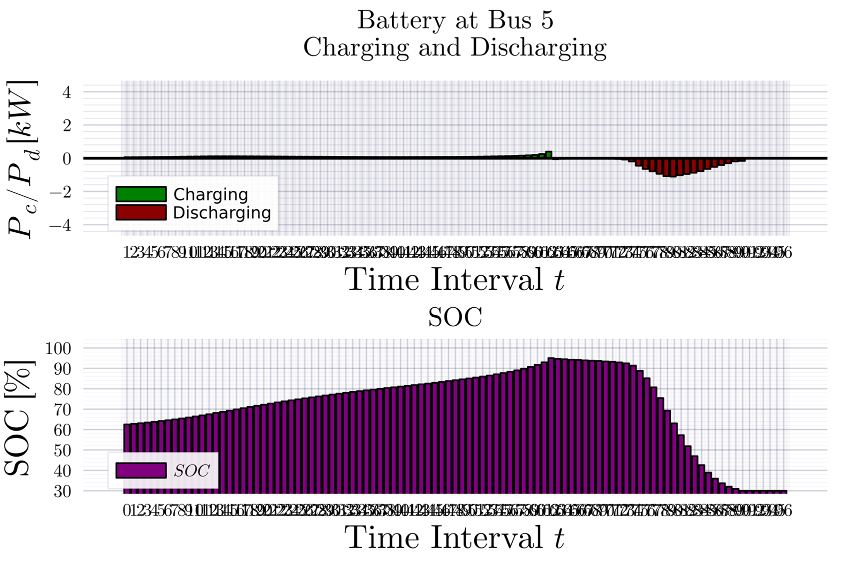
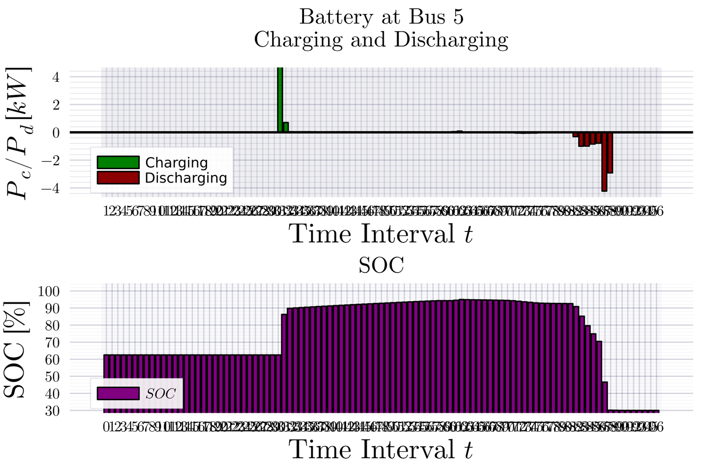
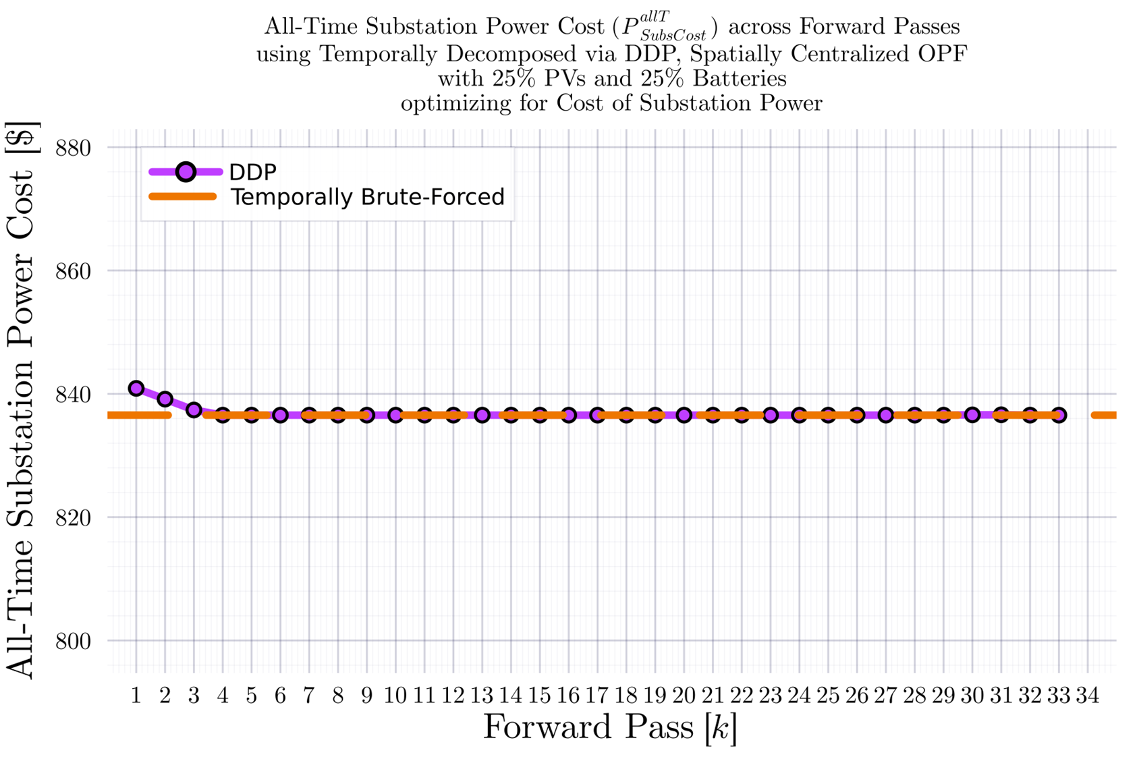
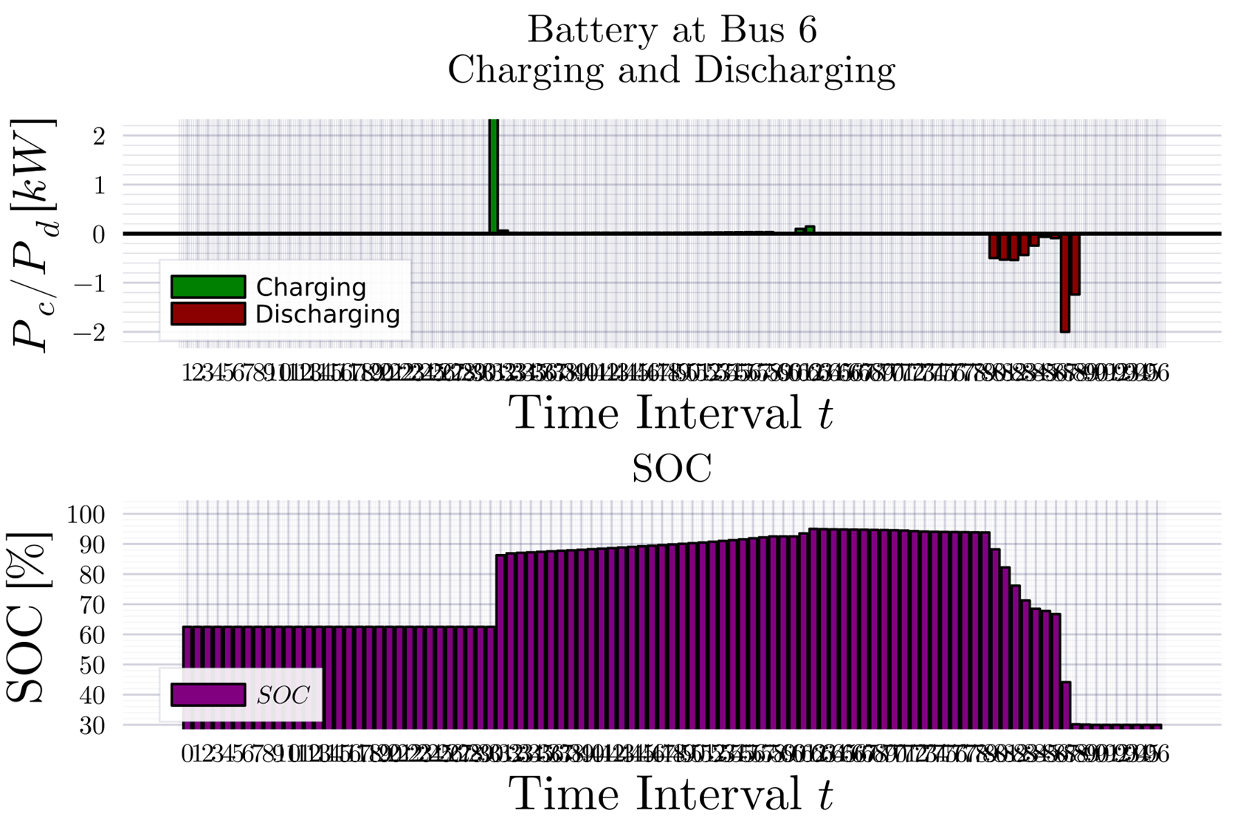

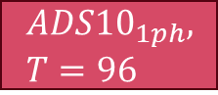


DDP Trajectory vs #Forward Passes $[k]$ Terminal SOC Constraint Relaxed
$$ADS{10}_{1ph}, T=96$$
BruteForced (BF)
$$DDP$$
Looks ‘successful’
$$k_{Max}=33$$

Slide 3
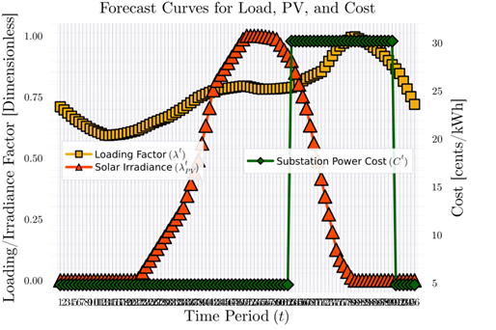
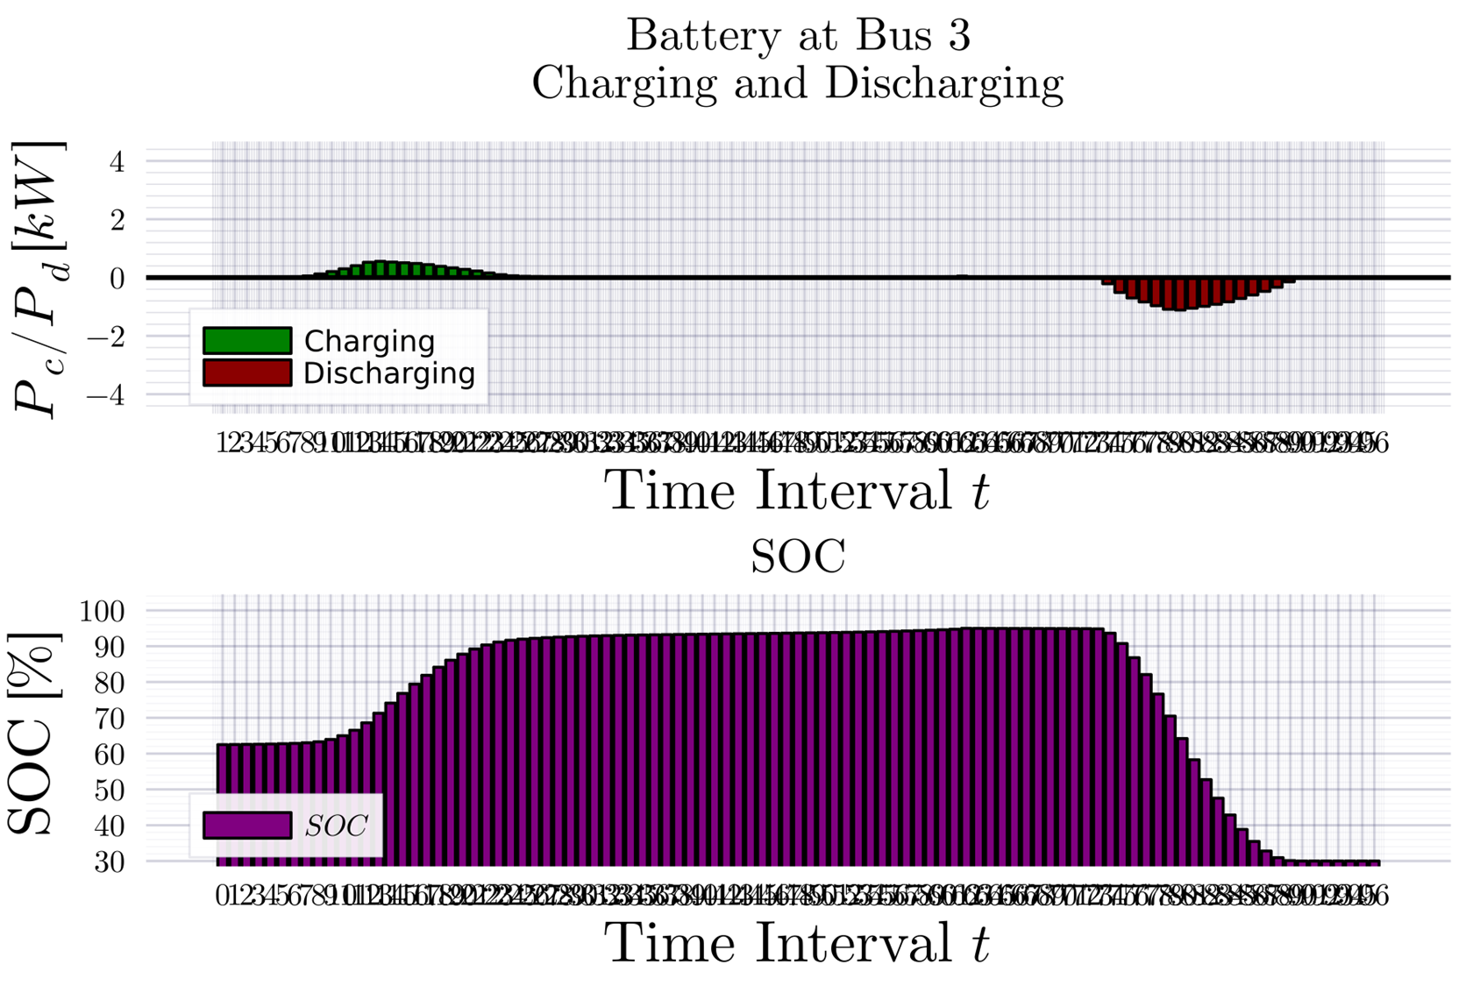
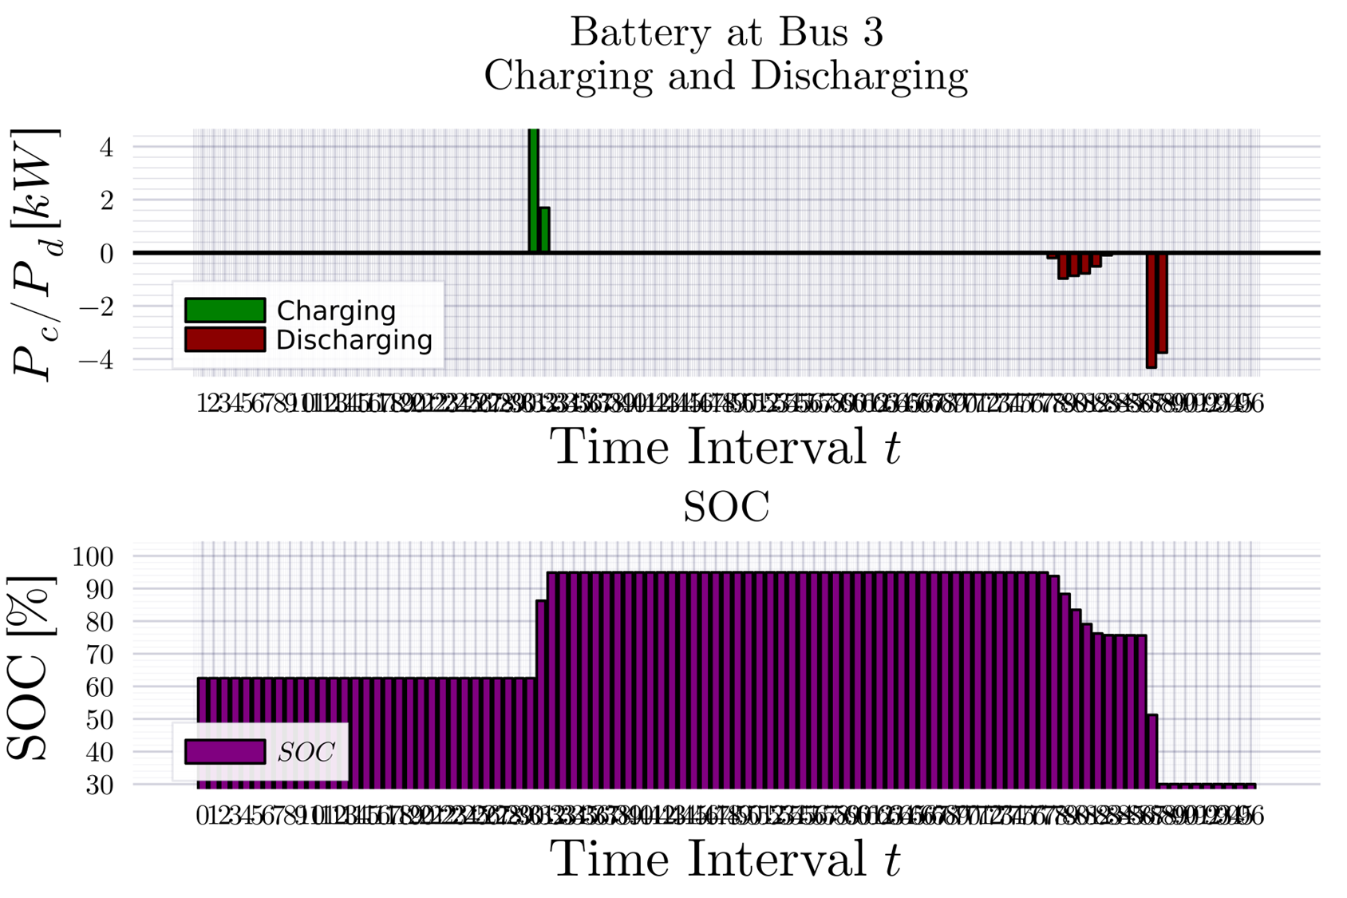
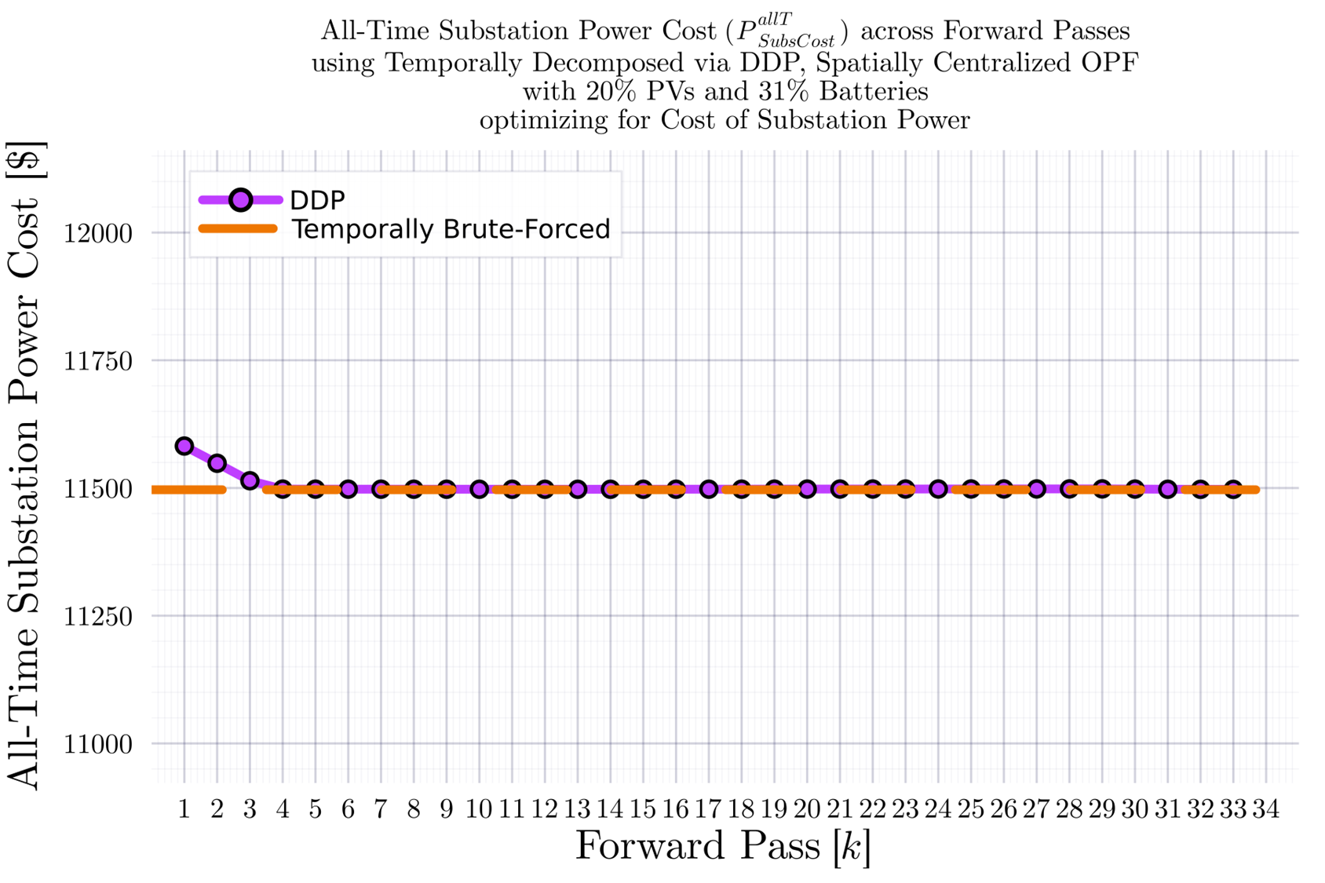

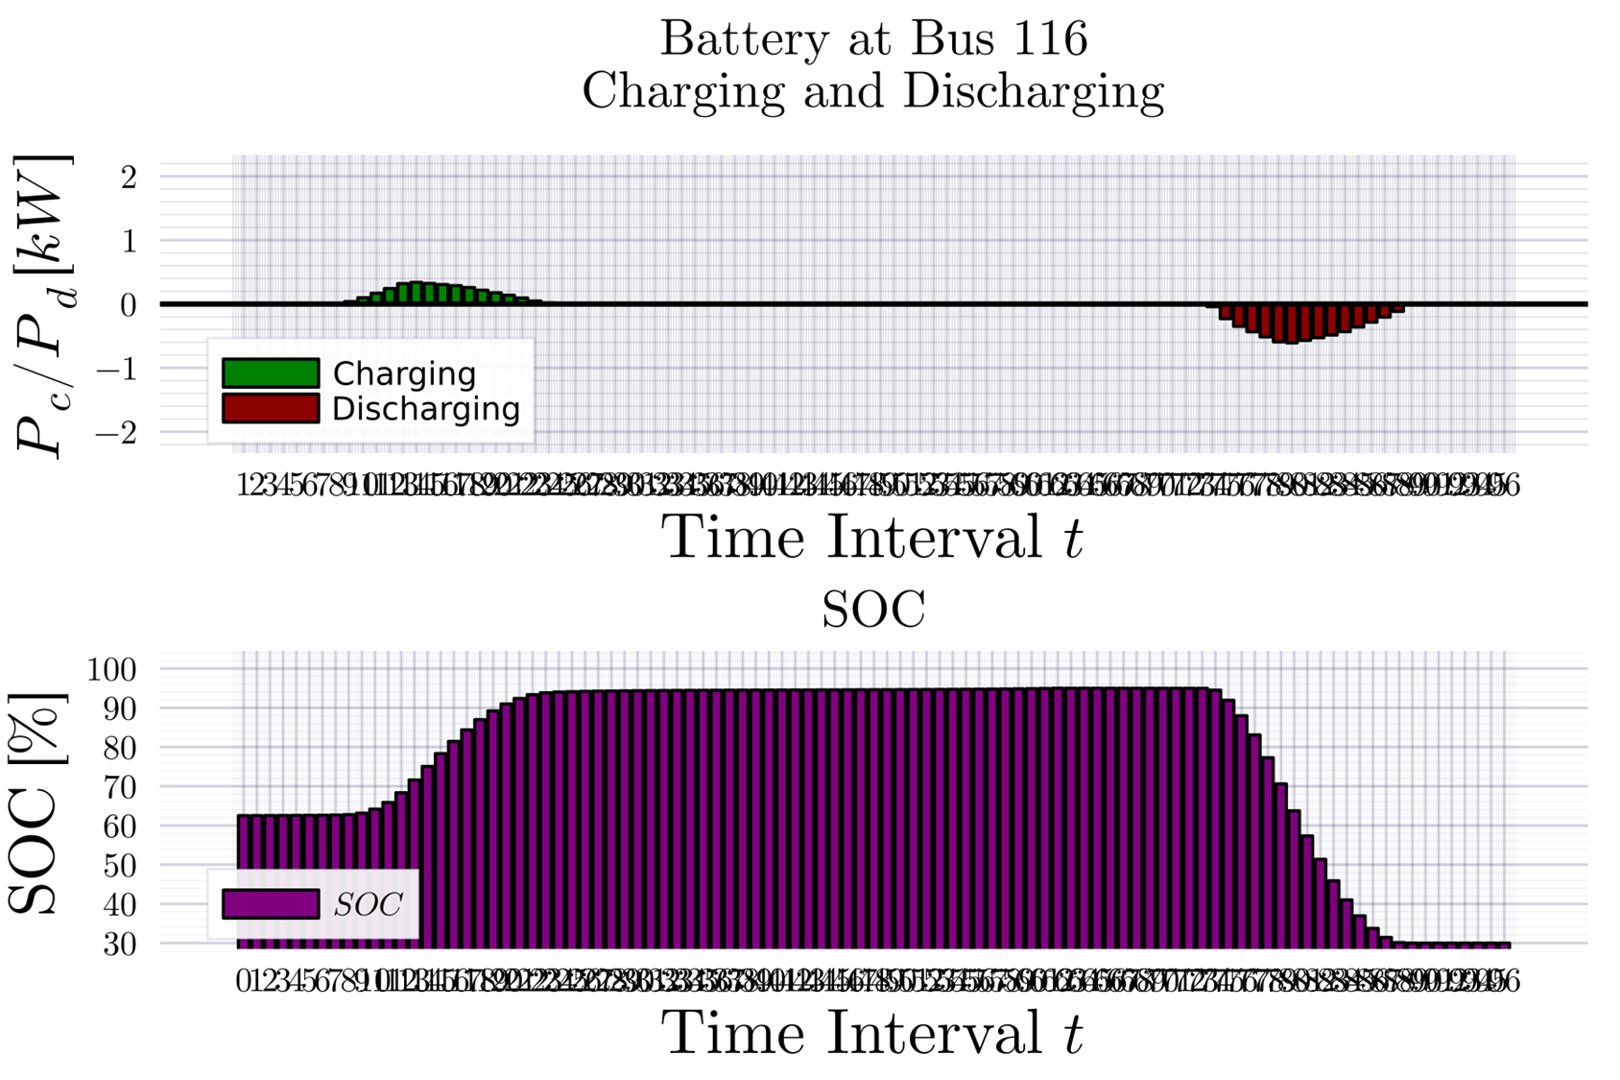
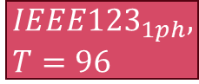
DDP Trajectory vs #Forward Passes $[k]$ Terminal SOC Constraint Relaxed
$$IEEE{123}_{1ph}, T=96$$
BruteForced (BF)
$$DDP$$
Looks ‘successful’
$$k_{Max}=33$$

Slide 4
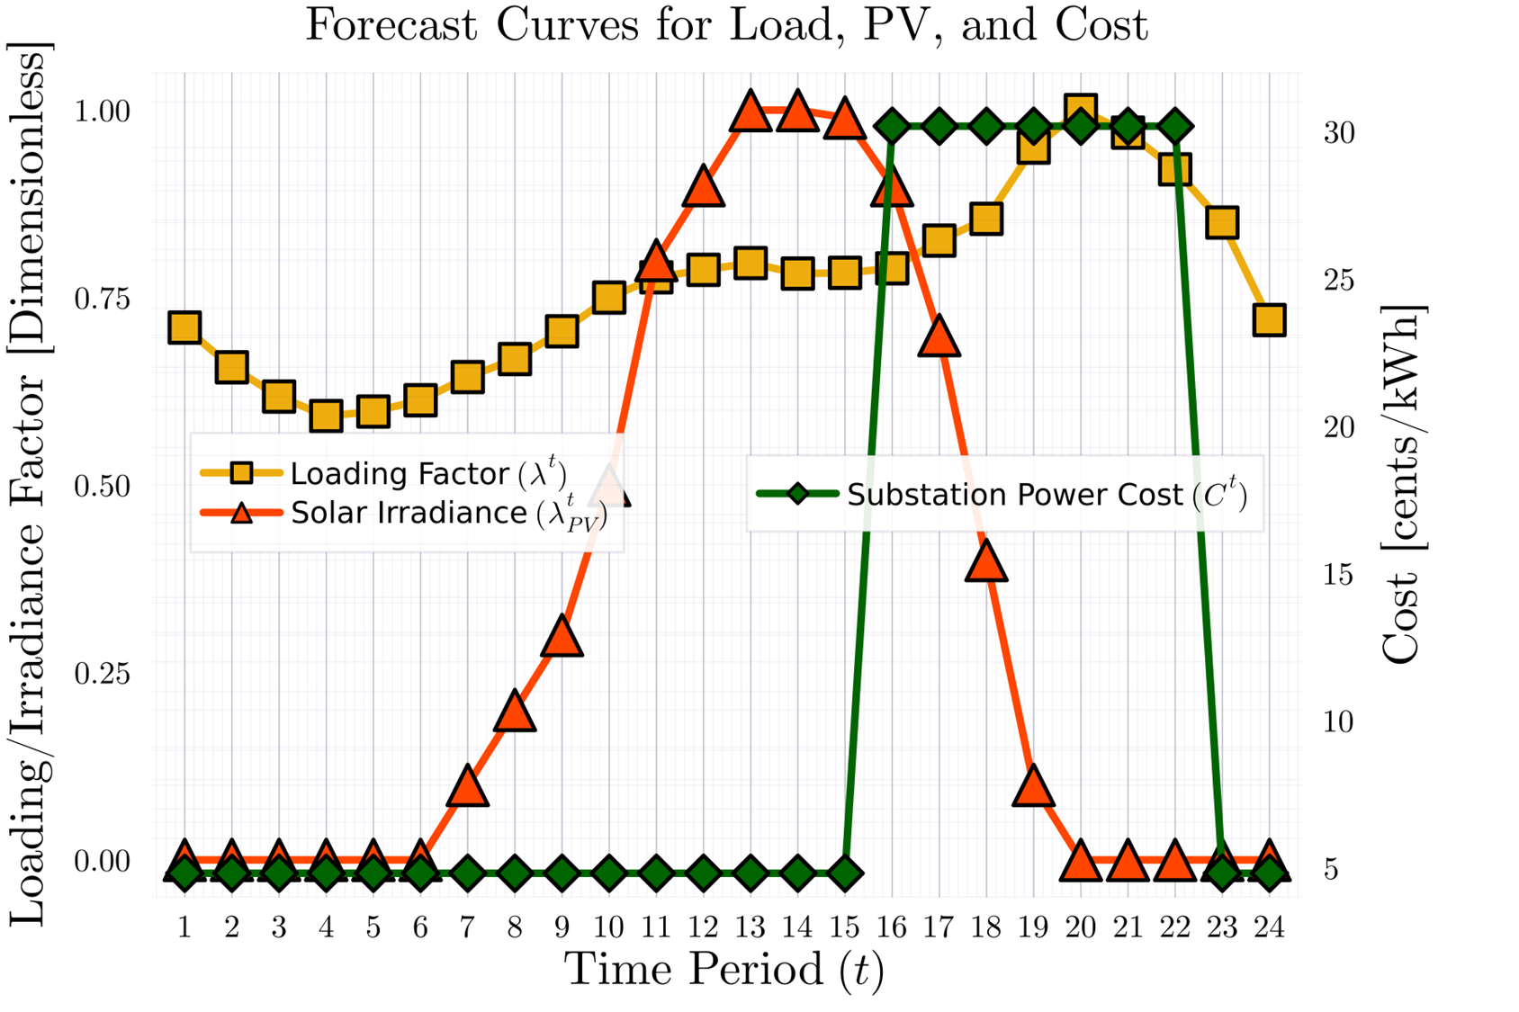
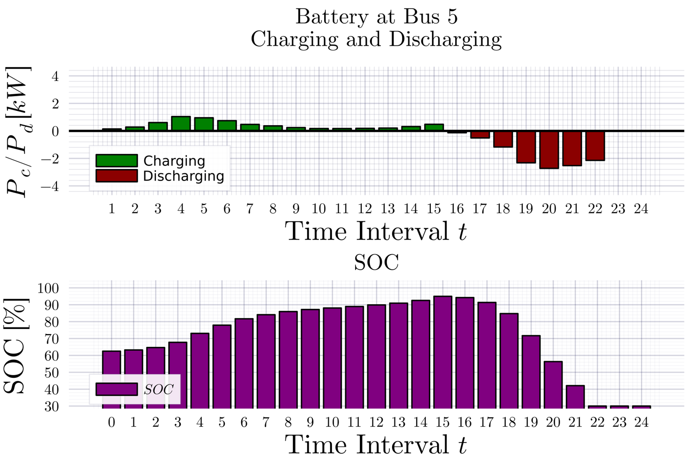
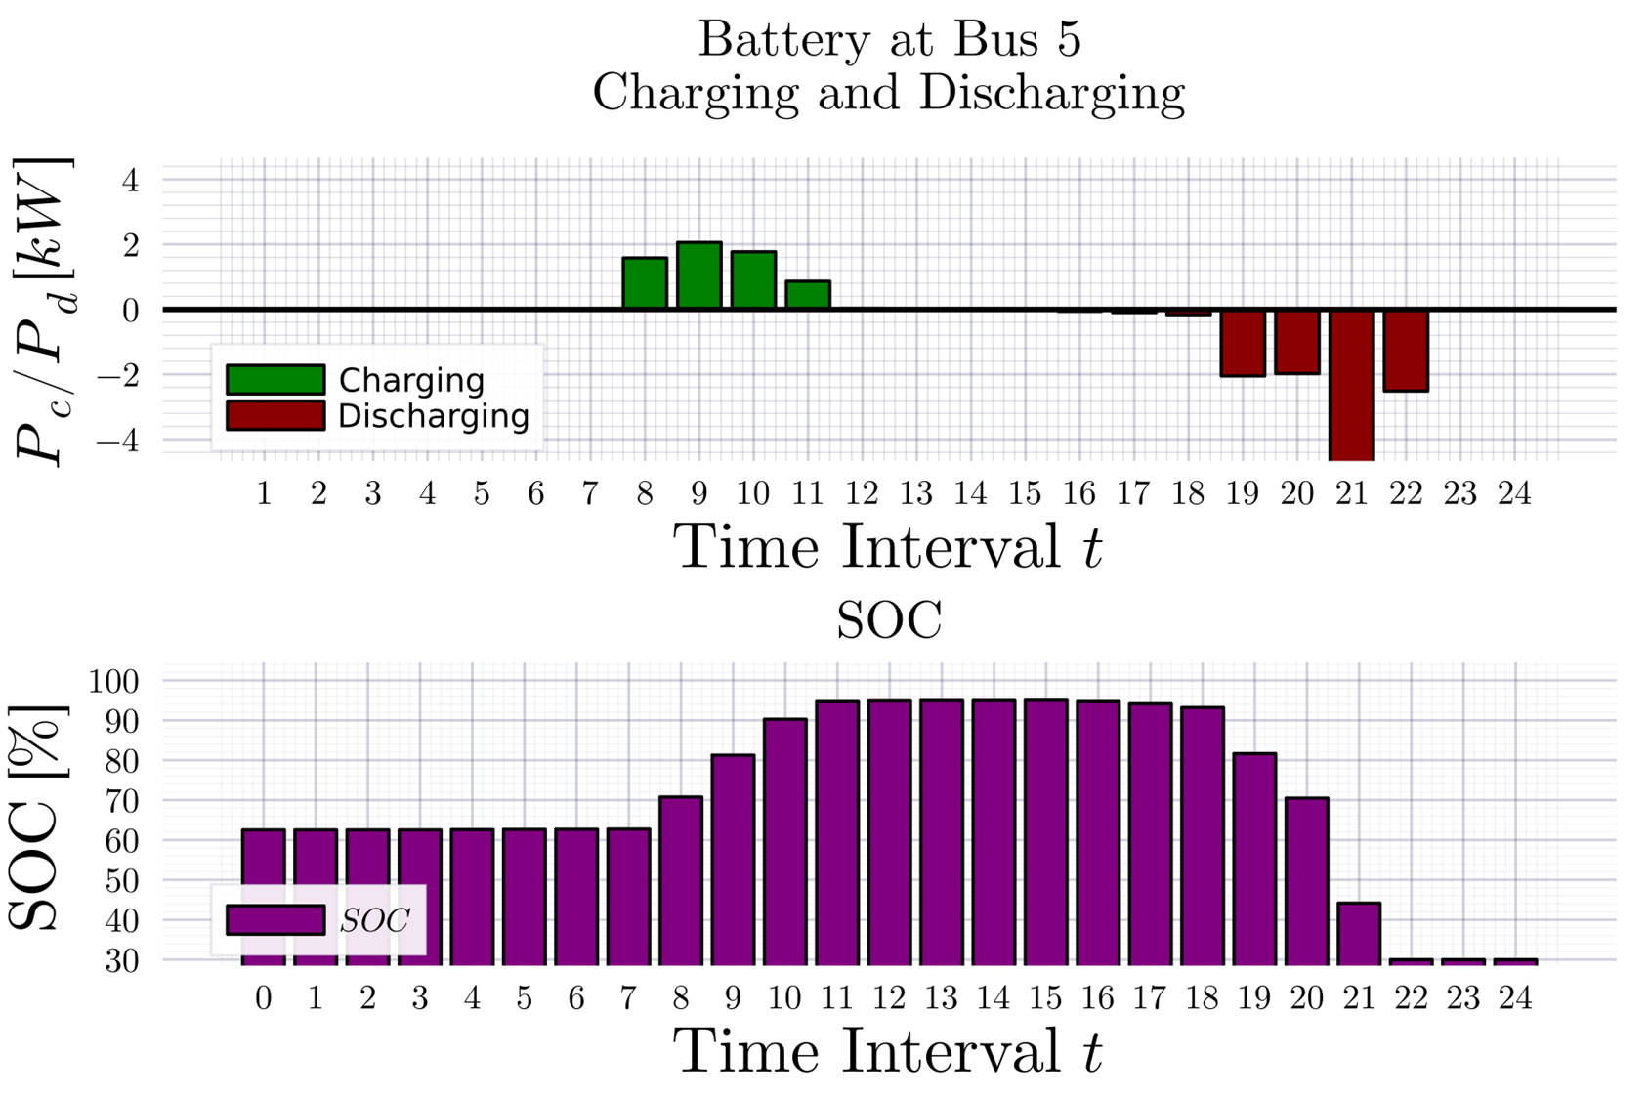
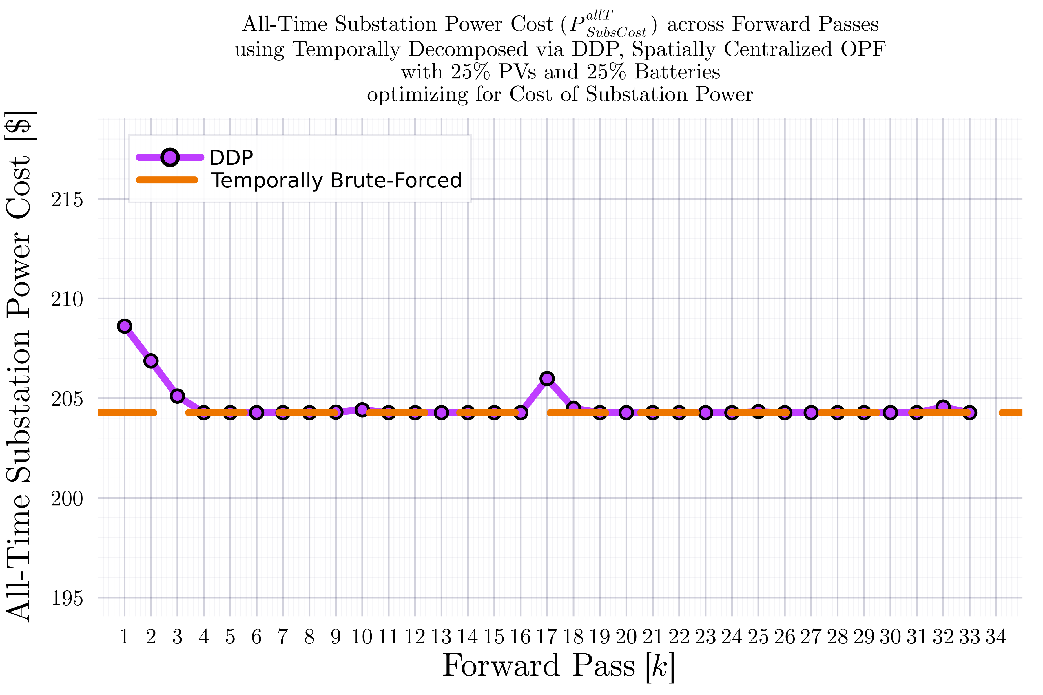
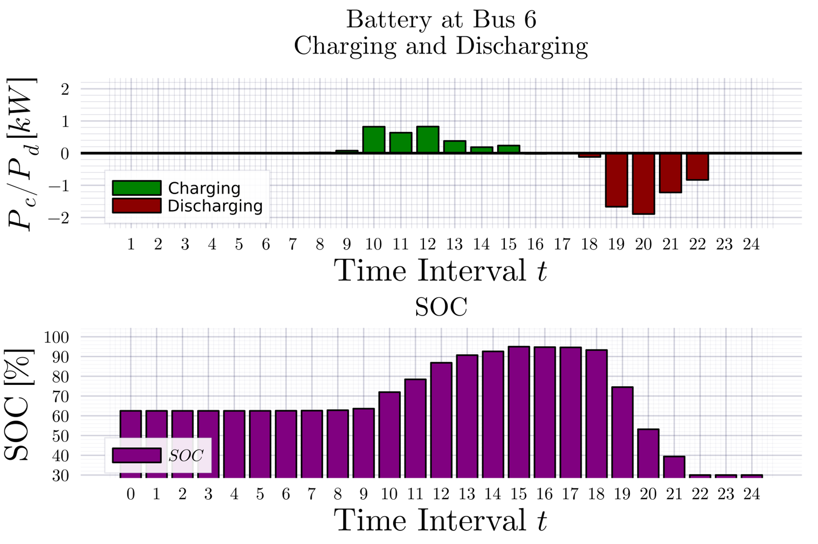
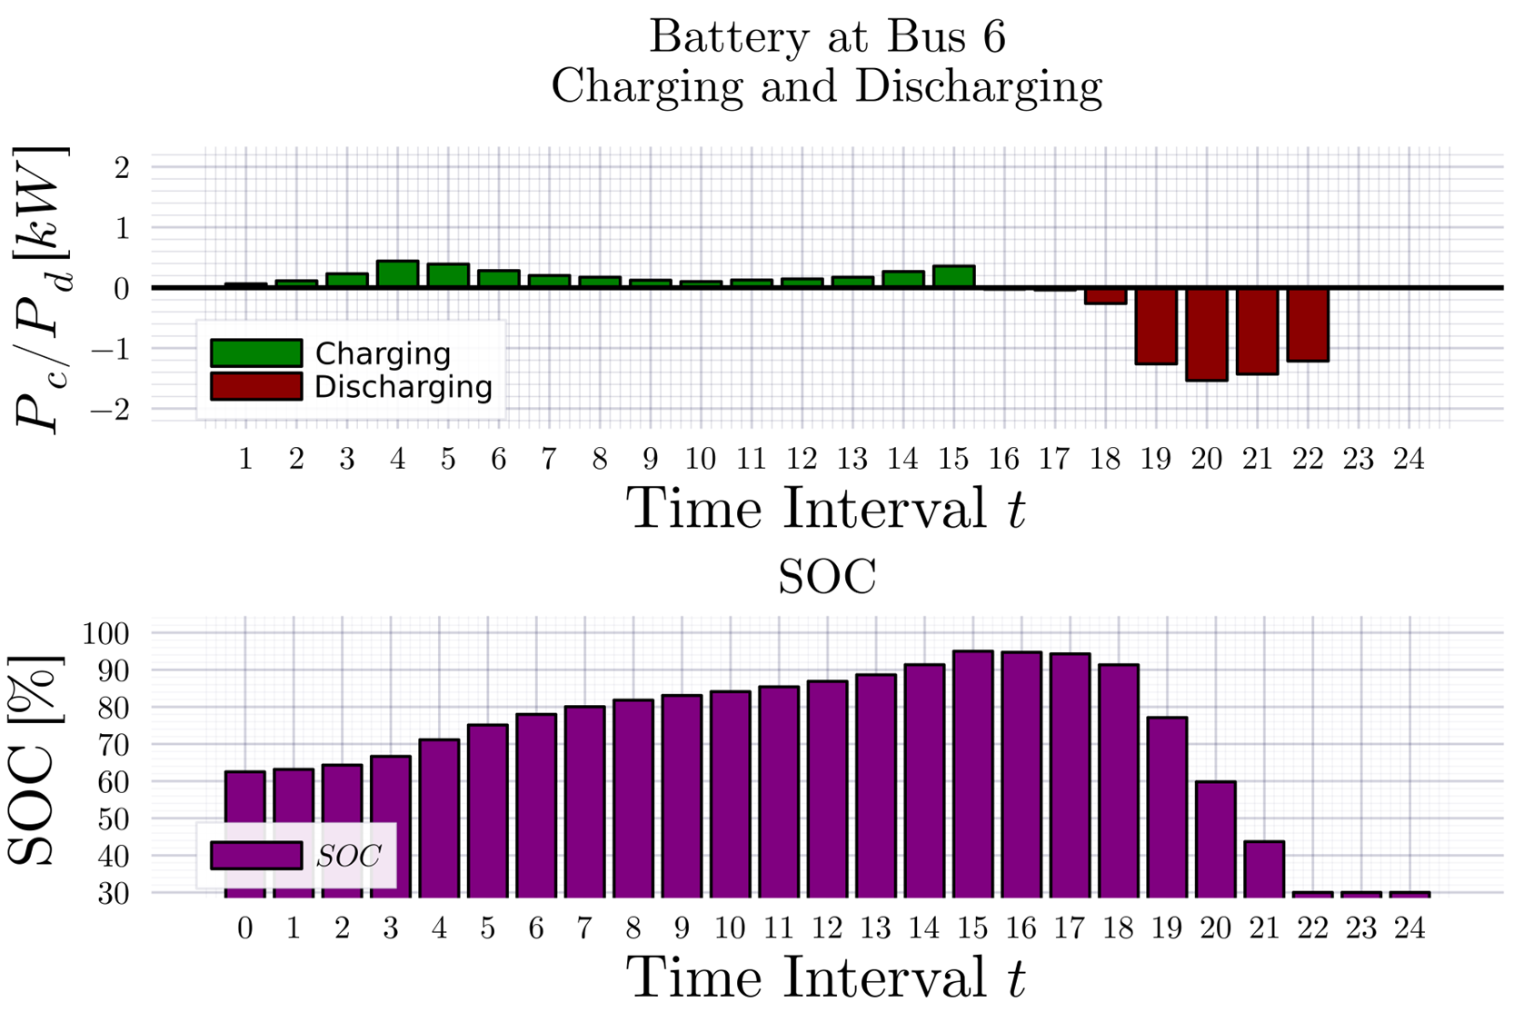
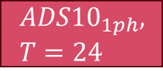
DDP Trajectory vs #Forward Passes $[k]$ Terminal SOC Constraint Relaxed
$$ADS{10}_{1ph}, T=24$$
BruteForced (BF)
$$DDP$$
Looks ‘successful’
$$k_{Max}=33$$

Slide 5
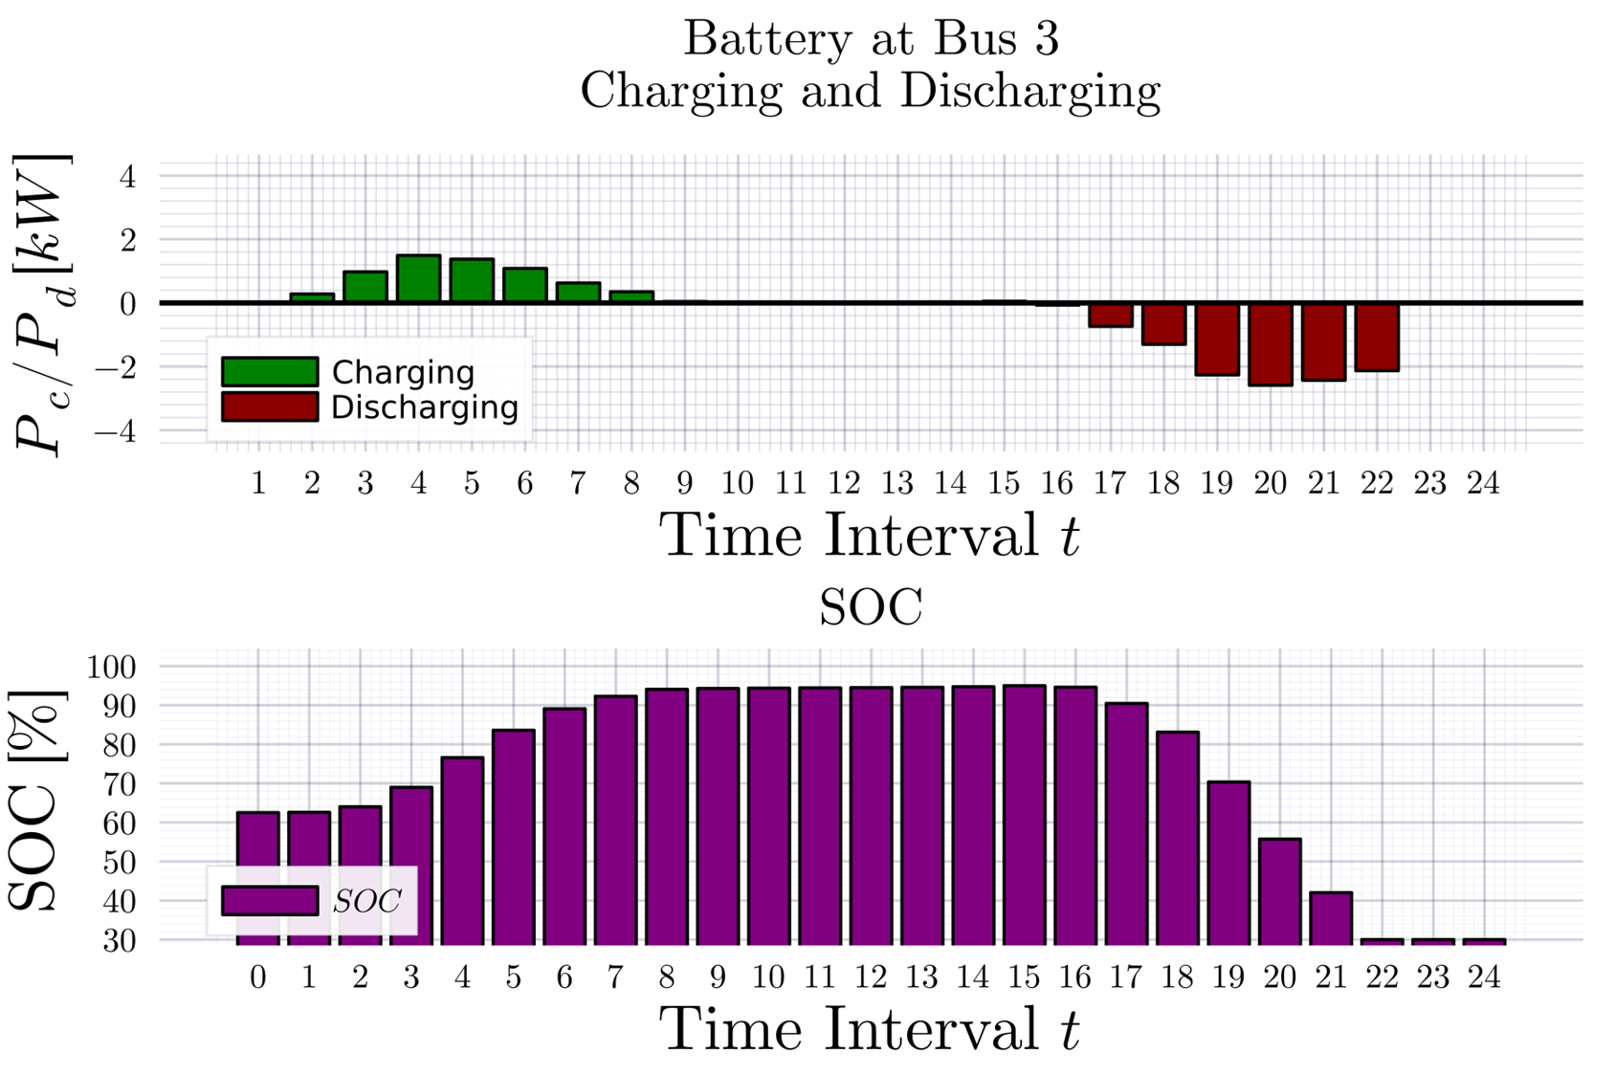
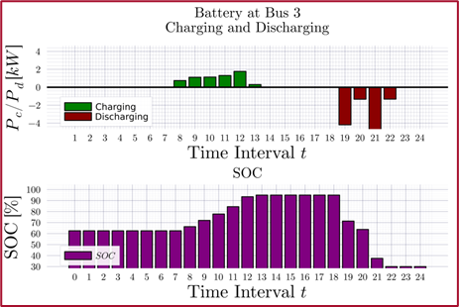
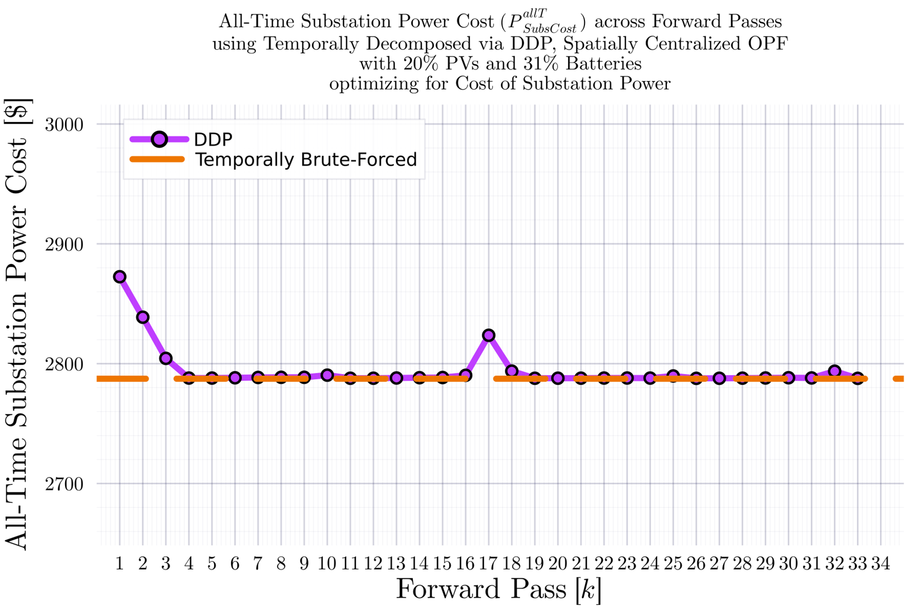
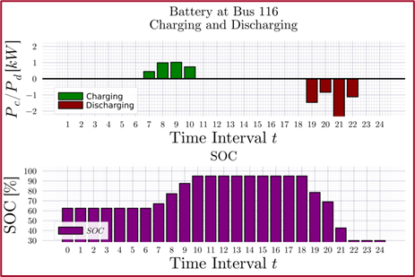
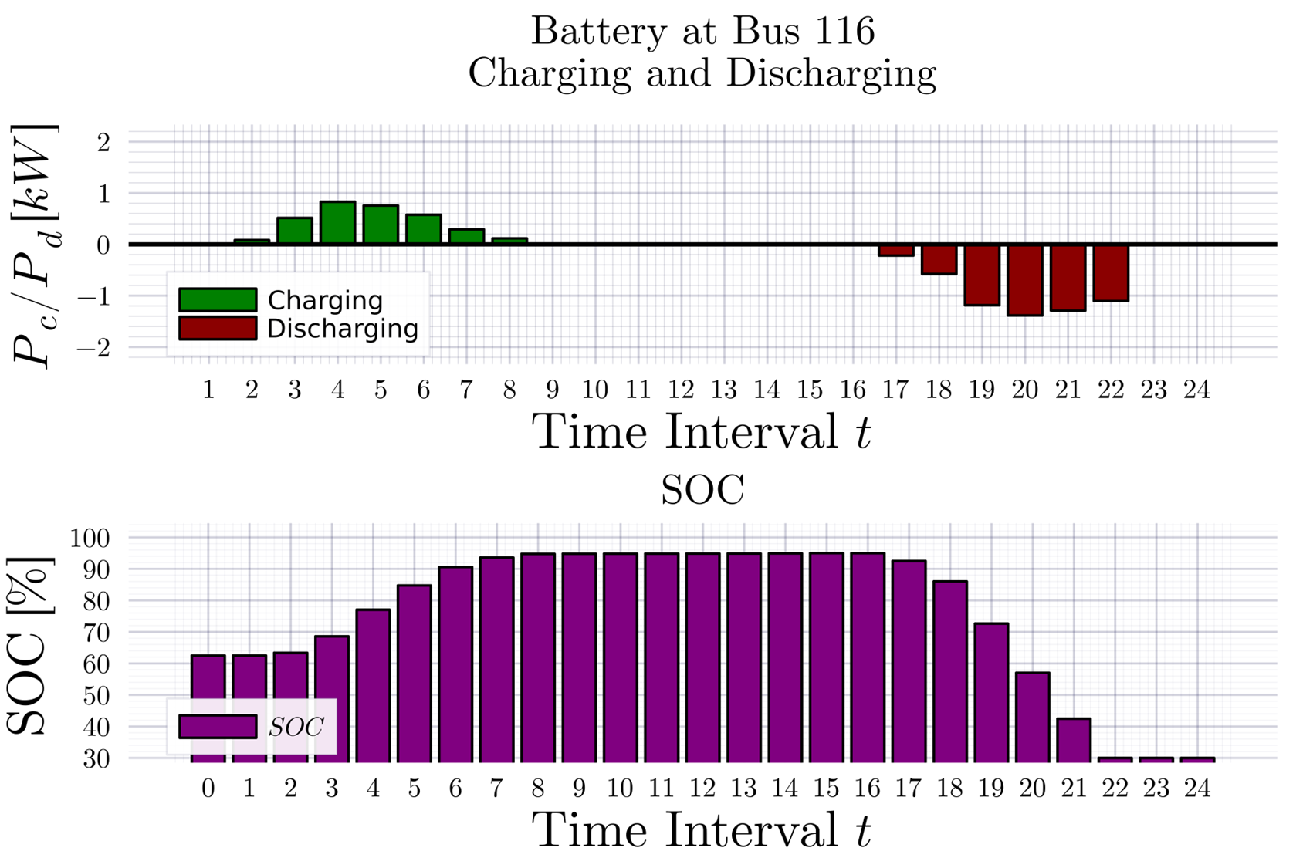
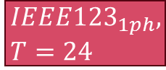
DDP Trajectory vs #Forward Passes $[k]$ Terminal SOC Constraint Relaxed
$$IEEE{123}_{1ph}, T=24$$
BruteForced (BF)
$$DDP$$
Looks ‘successful’
$$k_{Max}=33$$

Slide 6
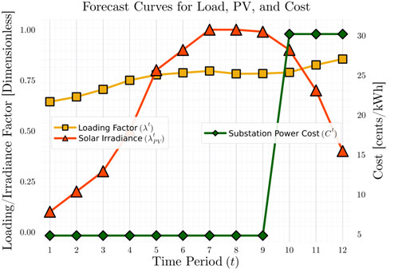
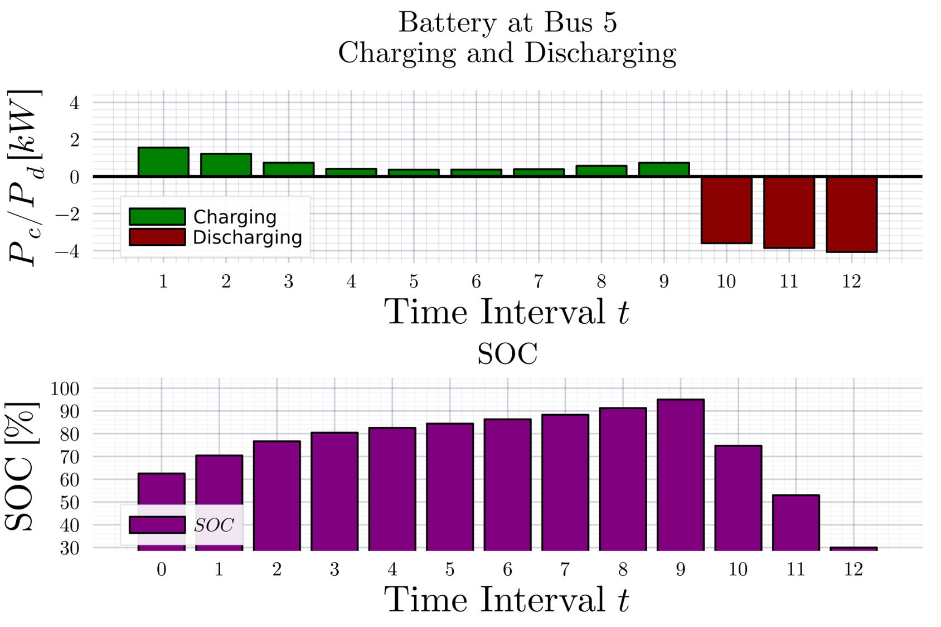
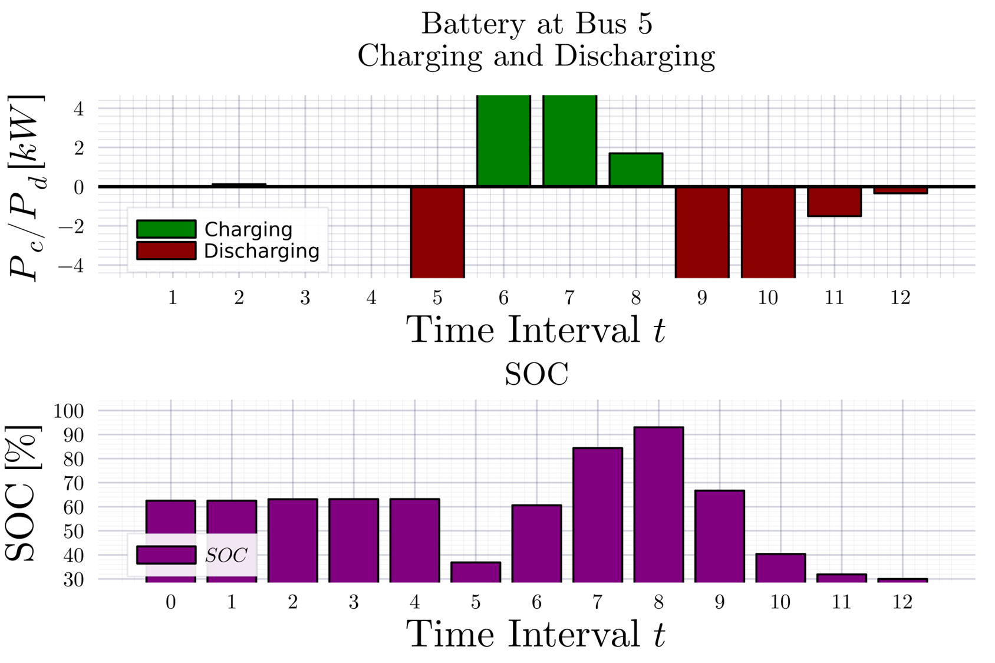
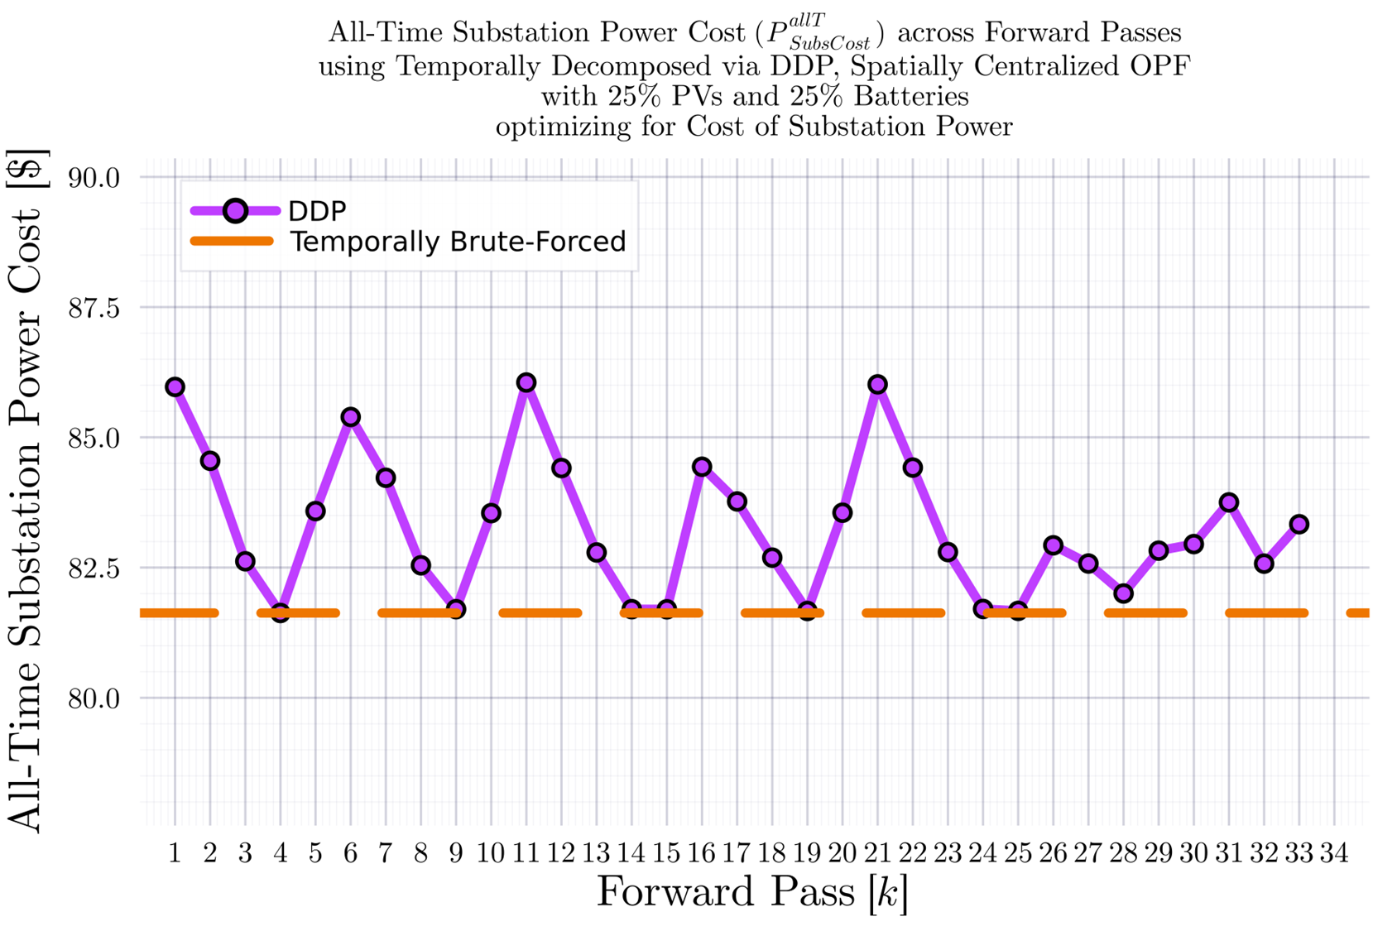
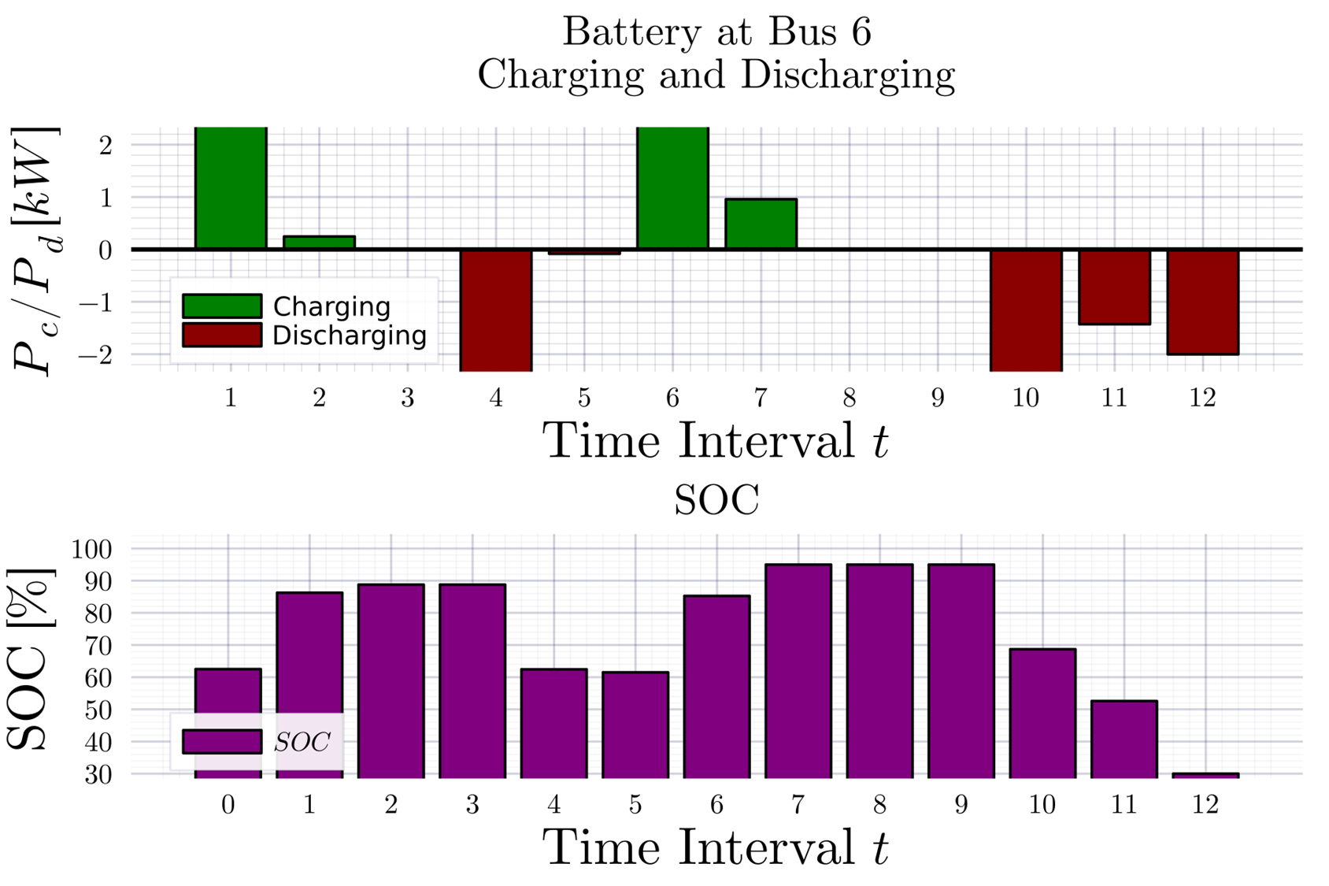
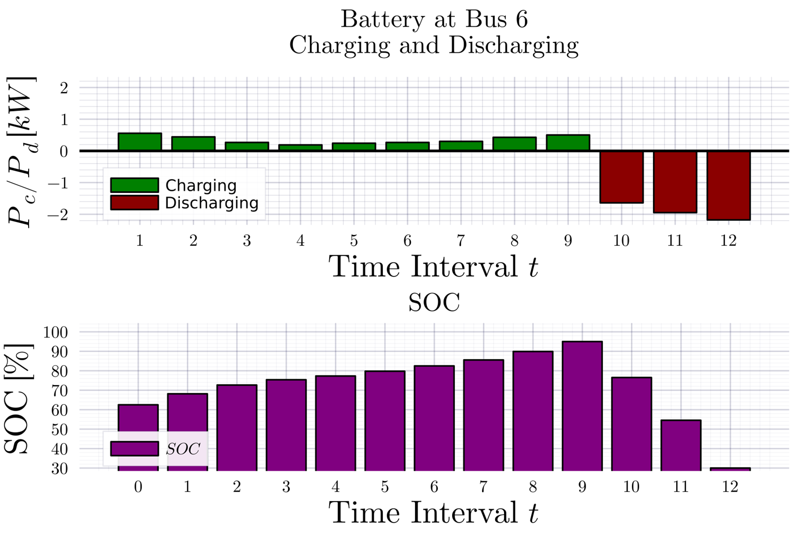
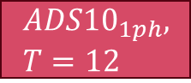
DDP Trajectory vs #Forward Passes $[k]$ Terminal SOC Constraint Relaxed
$$ADS{10}_{1ph}, T=12$$
BruteForced (BF)
$$DDP$$
Will NOT converge
$$k_{Max}=33$$
Even if not converging, it at least does ‘hit’ the optimal value periodically.

Slide 7
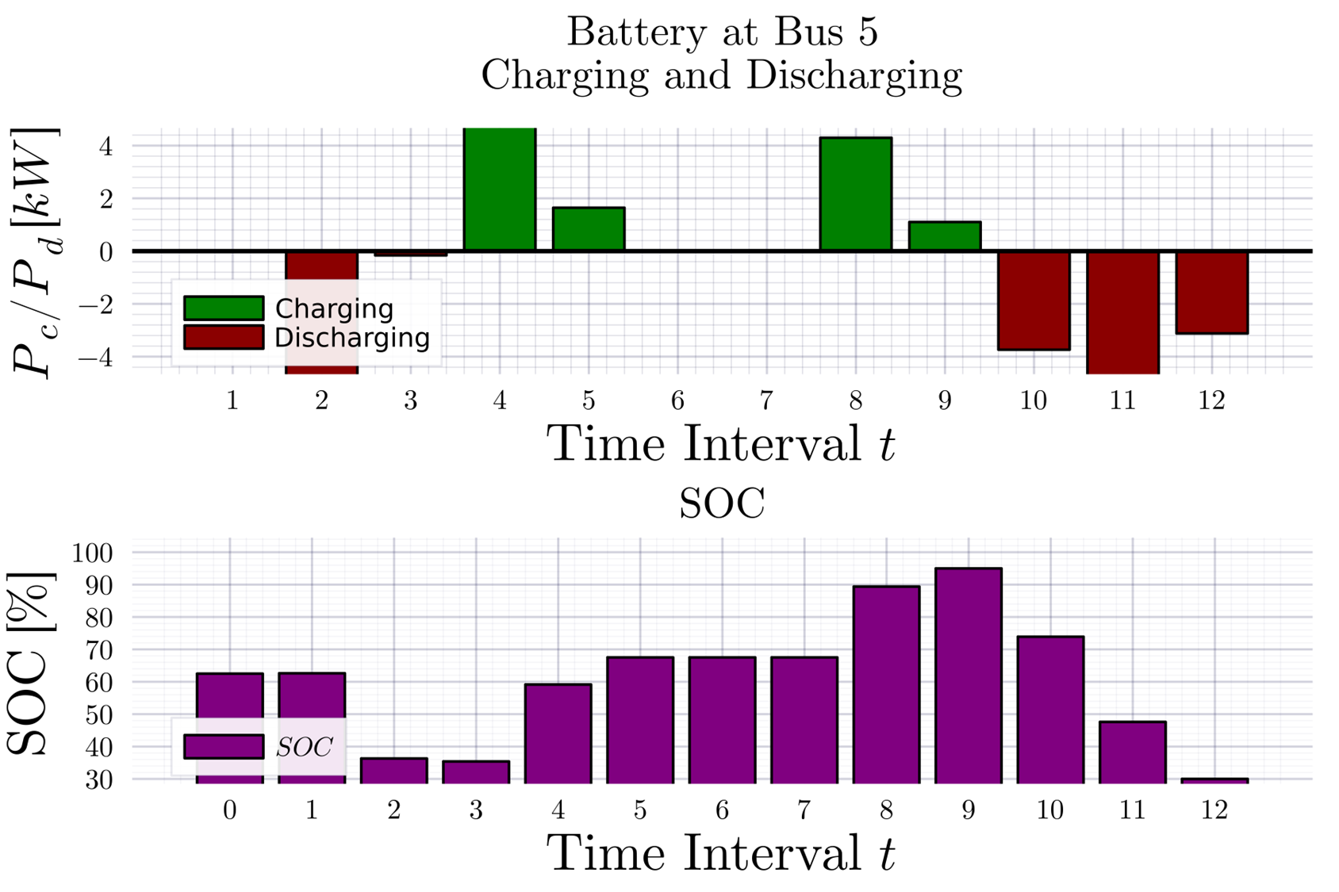
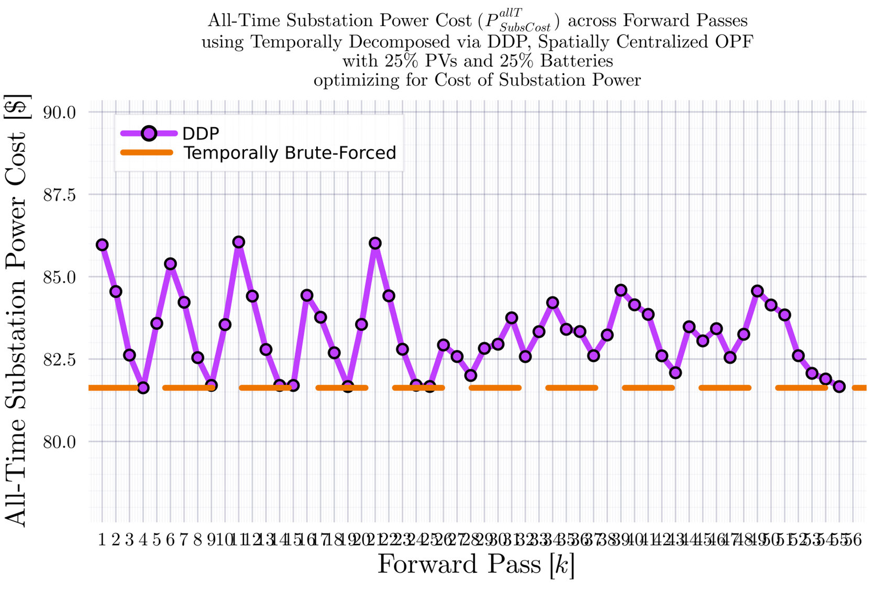

DDP Trajectory vs #Forward Passes $[k]$ Terminal SOC Constraint Relaxed
$$ADS{10}_{1ph}, T=12$$
BruteForced (BF)
$$DDP$$
Will NOT converge
$$k_{Max}=55$$
Even if not converging, it at least does ‘hit’ the optimal value periodically.

Slide 8
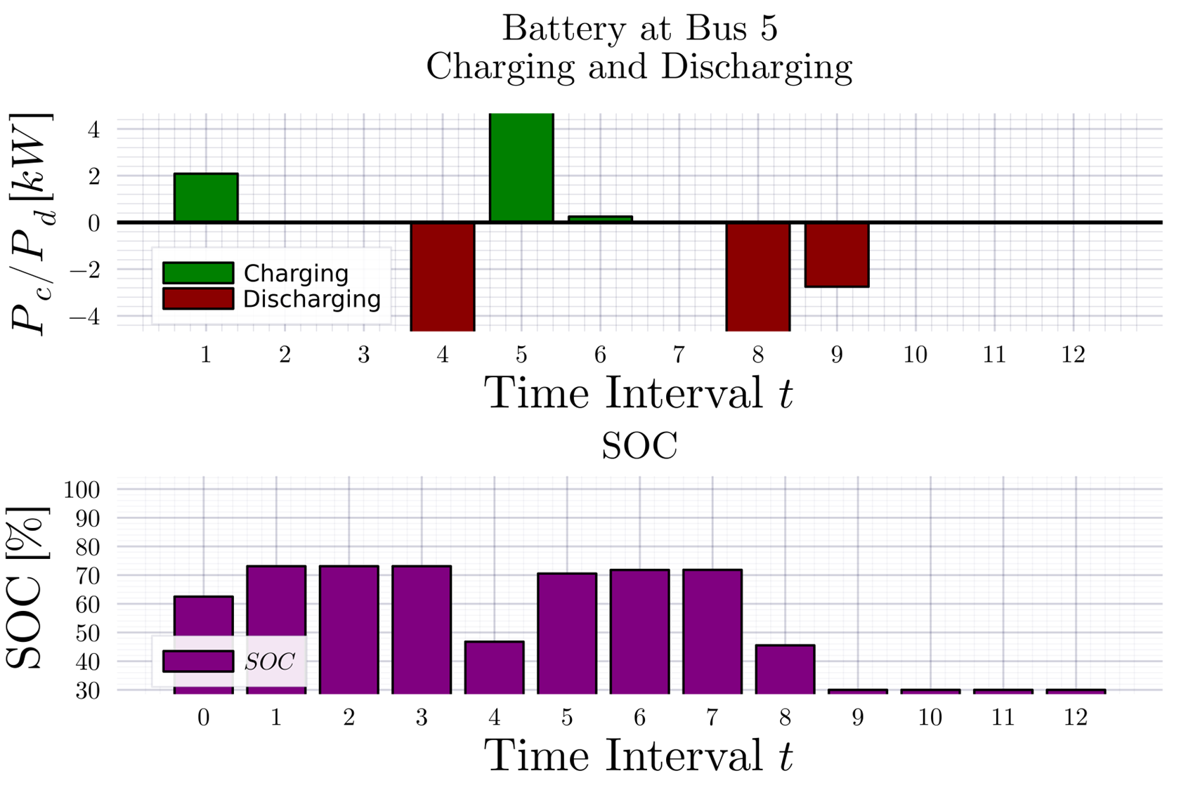
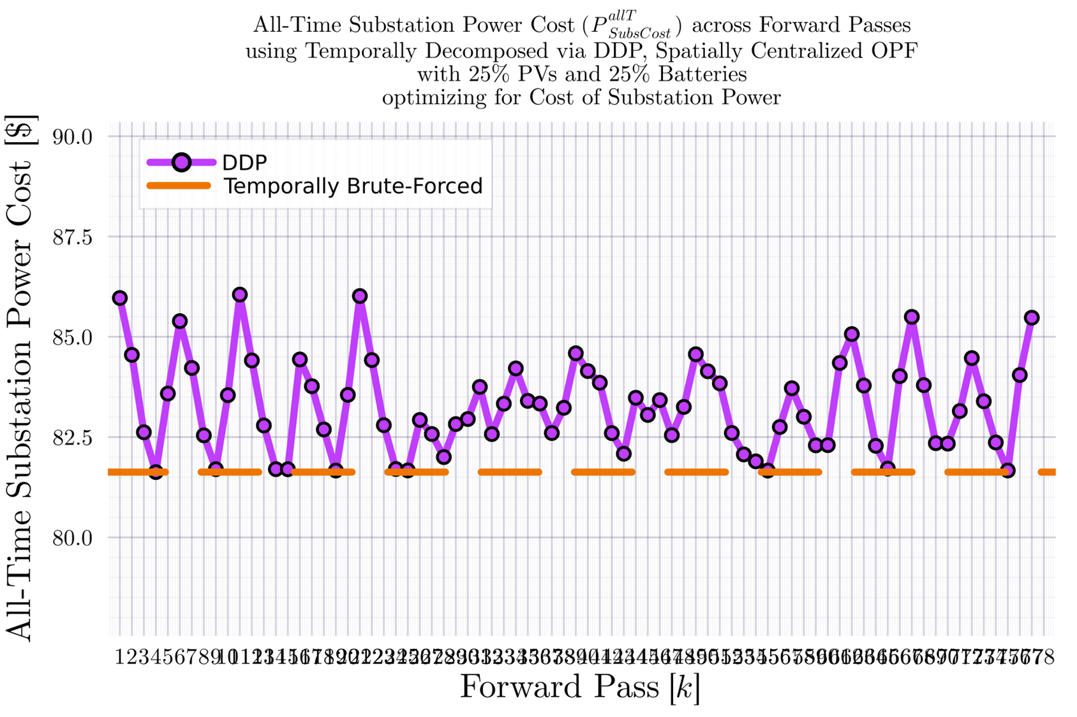
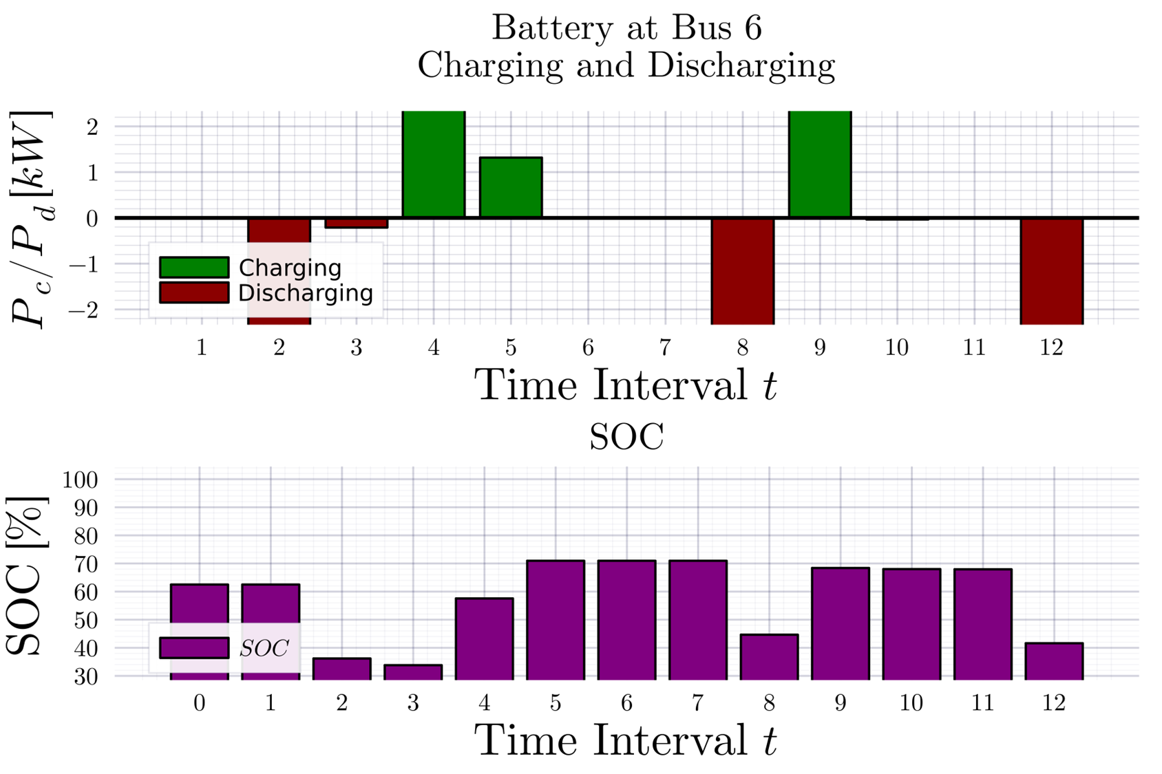

DDP Trajectory vs #Forward Passes $[k]$ Terminal SOC Constraint Relaxed
$$ADS{10}_{1ph}, T=12$$
BruteForced (BF)
$$DDP$$
Will NOT converge
$$k_{Max}=77$$
Even if not converging, it at least does ‘hit’ the optimal value periodically.

Slide 9
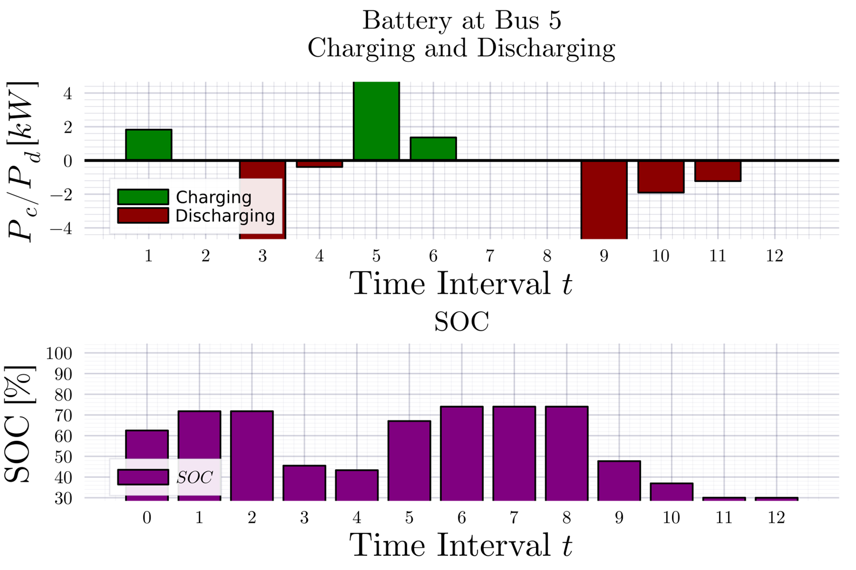
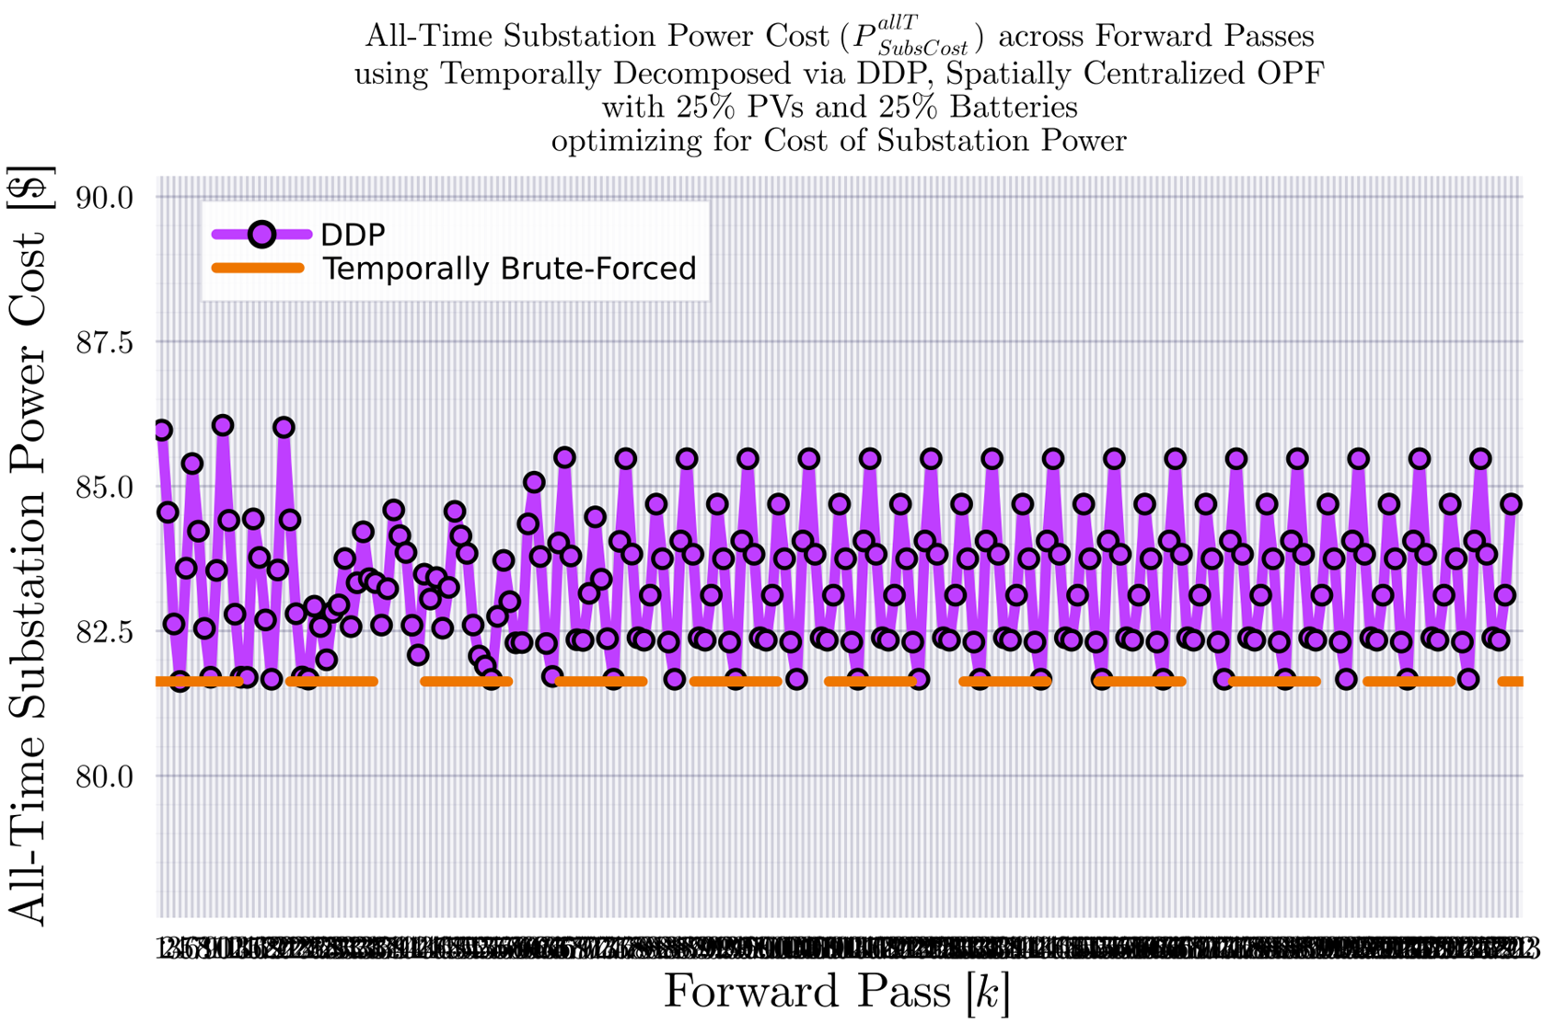
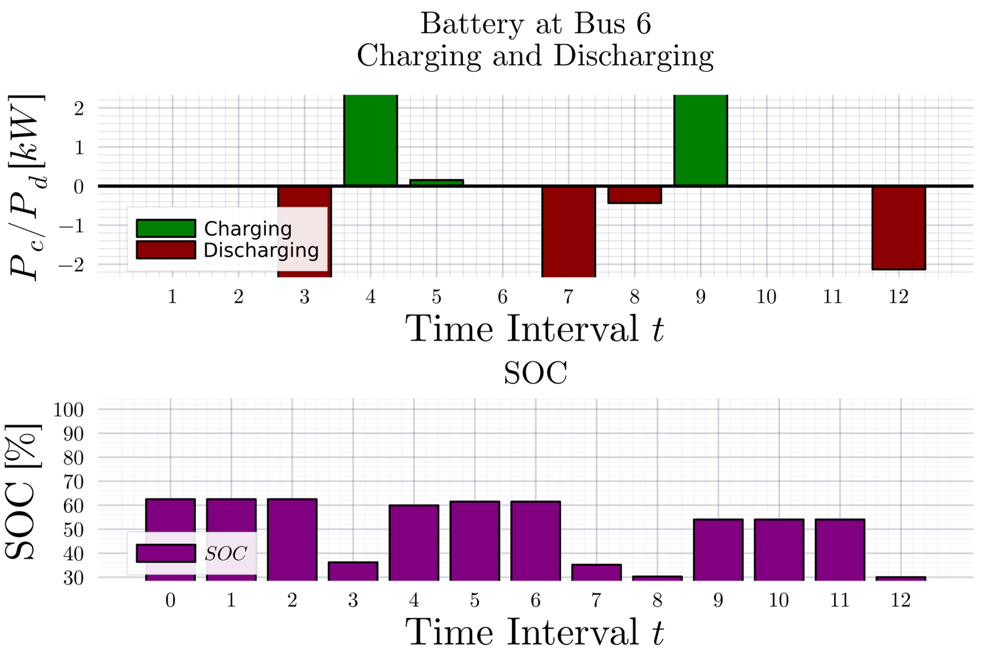

DDP Trajectory vs #Forward Passes $[k]$ Terminal SOC Constraint Relaxed
$$ADS{10}_{1ph}, T=12$$
BruteForced (BF)
$$DDP$$
Will NOT converge
$$k_{Max}=222$$
Even if not converging, it at least does ‘hit’ the optimal value periodically.

Slide 10

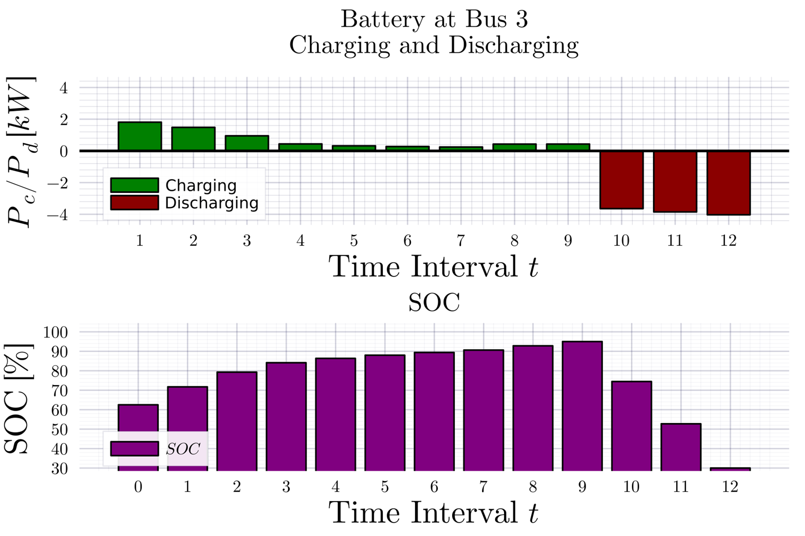
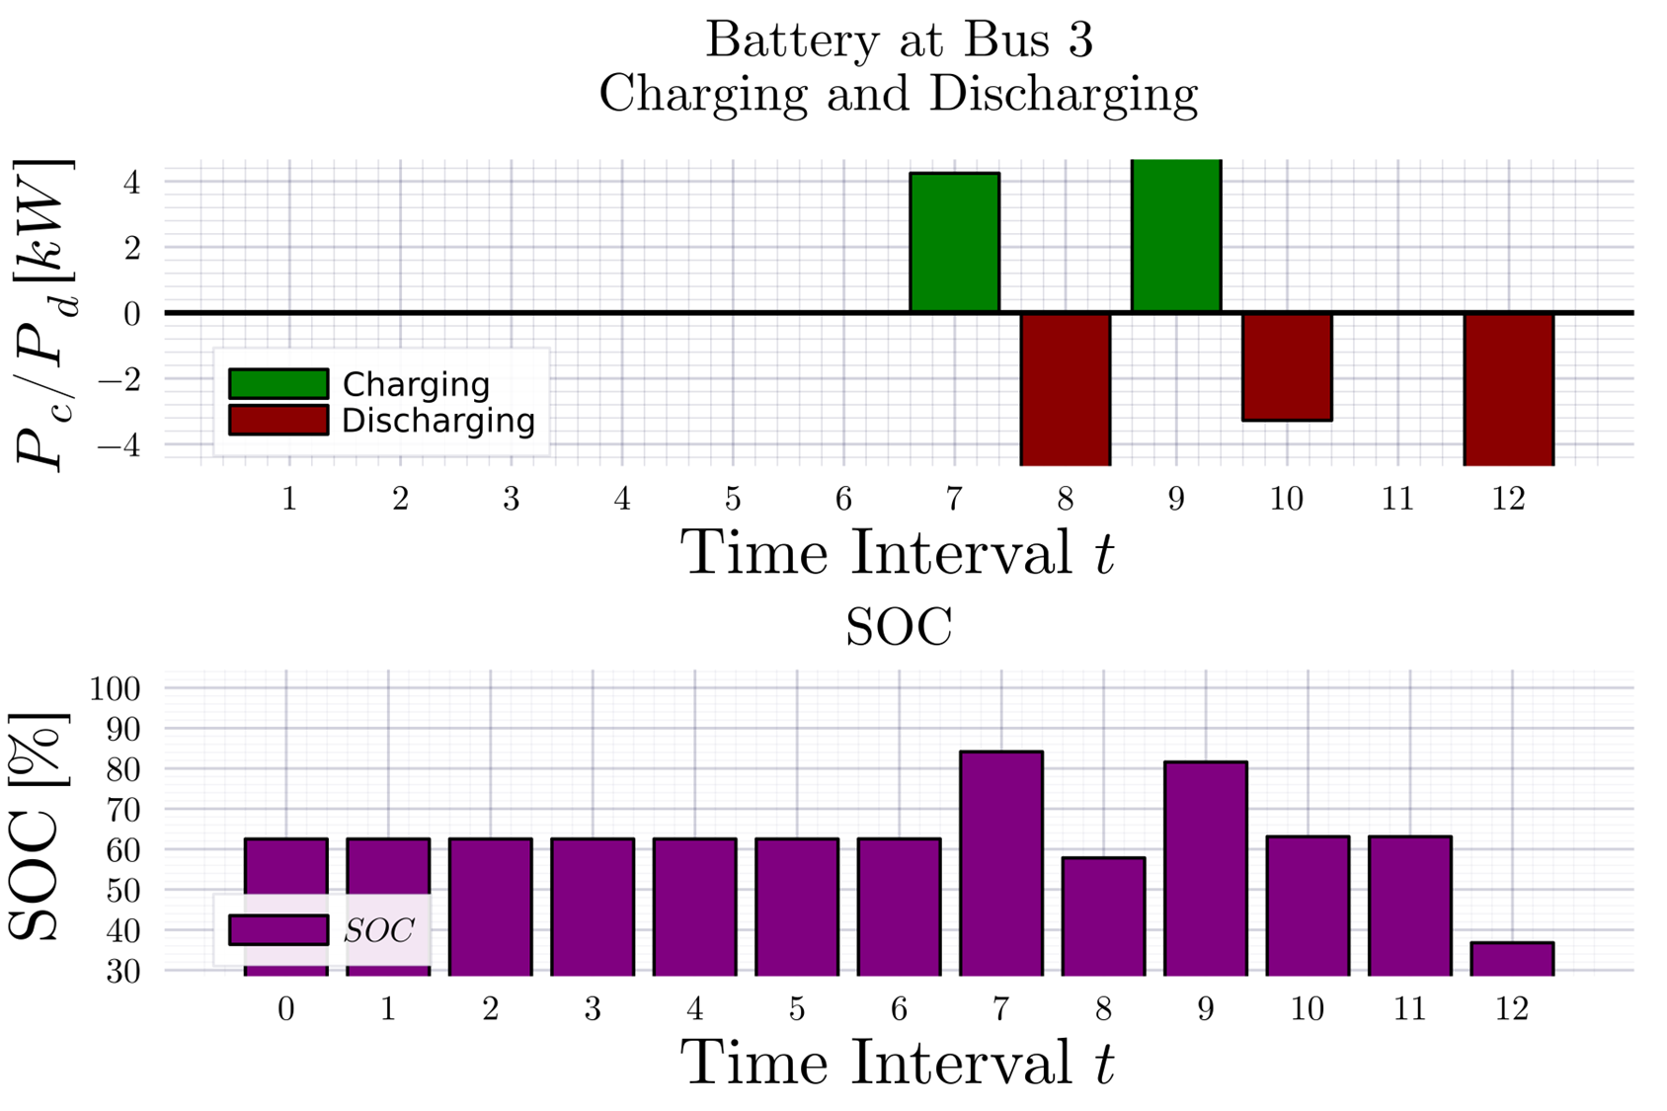
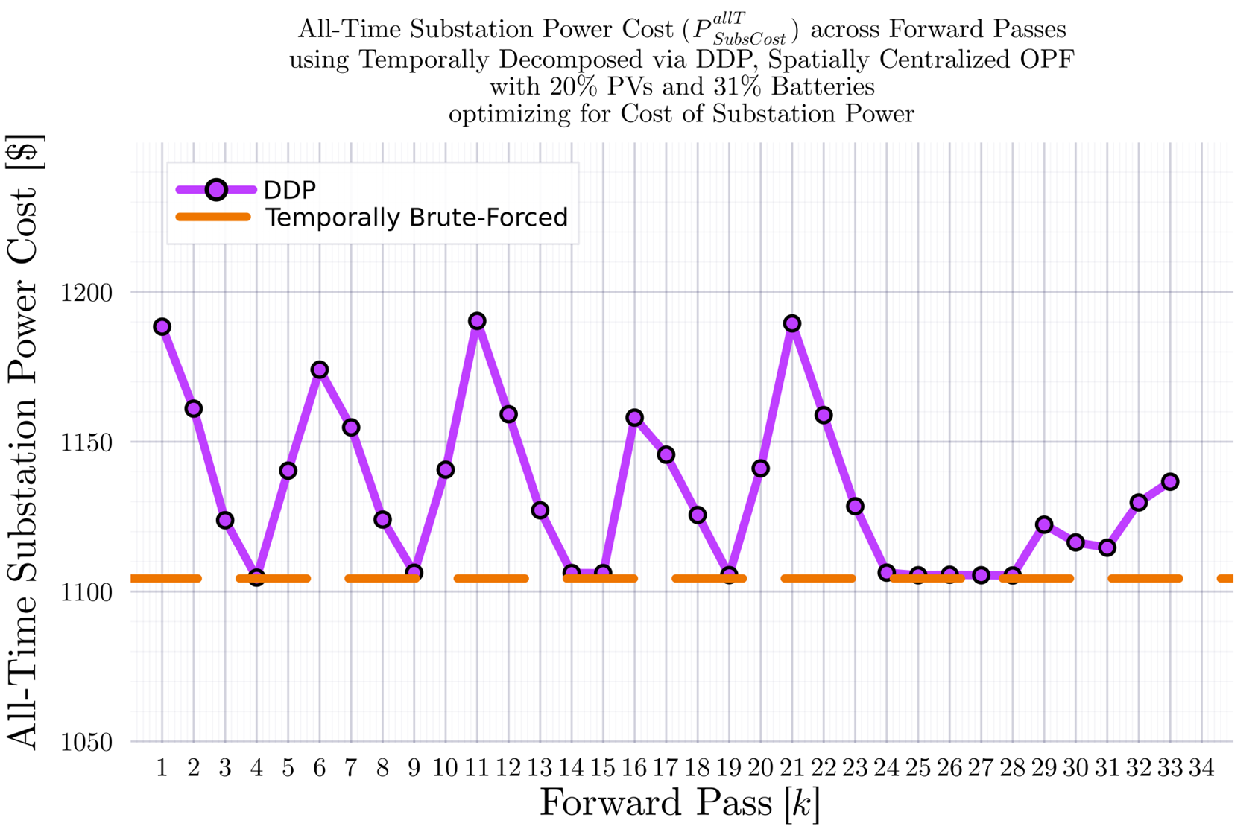

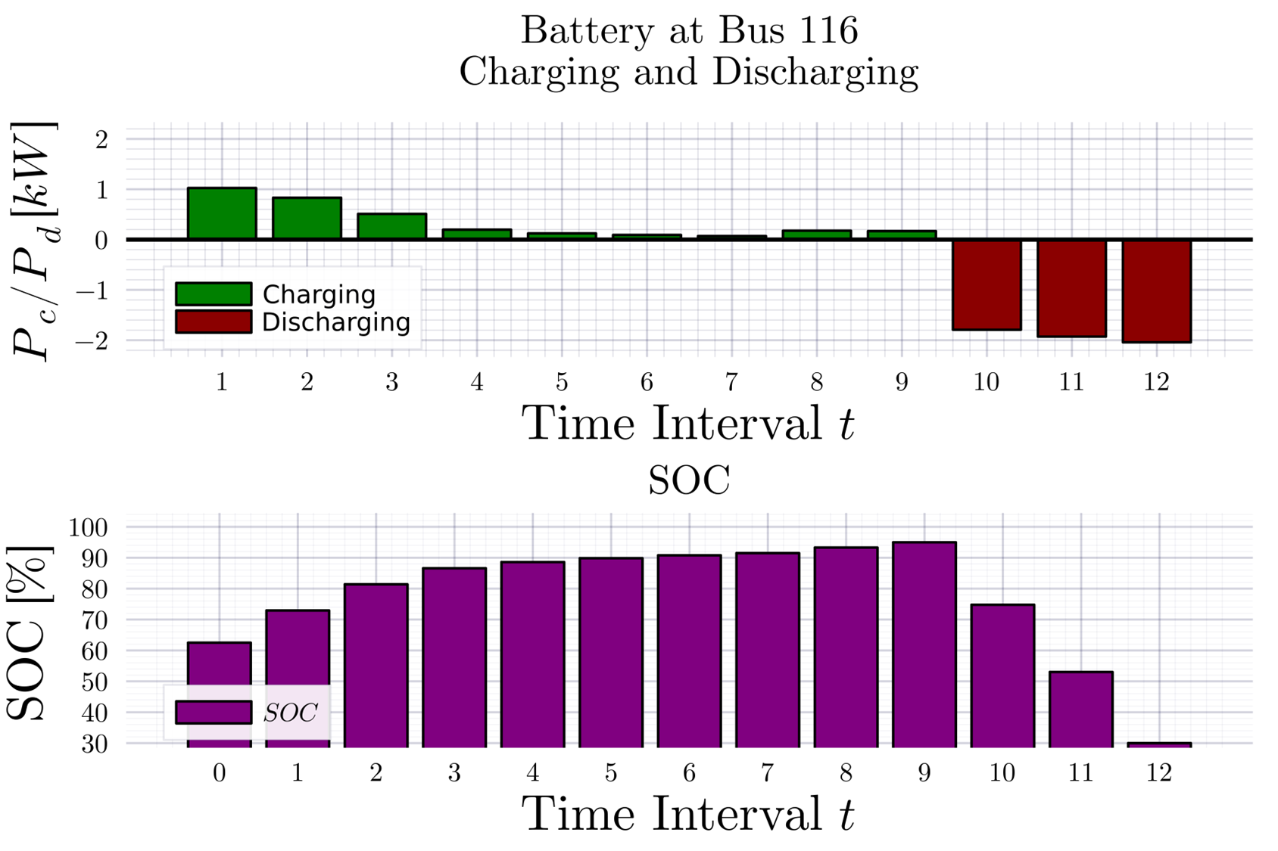
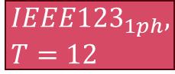
DDP Trajectory vs #Forward Passes $[k]$ Terminal SOC Constraint Relaxed
$$IEEE{123}_{1ph}, T=12$$
BruteForced (BF)
$$DDP$$
Will NOT converge
$$k_{Max}=33$$
Even if not converging, it at least does ‘hit’ the optimal value periodically.

Slide 11

Latest Slides End Here. Previous Slides Follow.

Slide 12




Decision Variables Comparison Terminal SOC Constraint Relaxed
$$ADS{10}_{1ph}, T=12$$
BruteForced (BF)
$$DDP$$

Slide 13
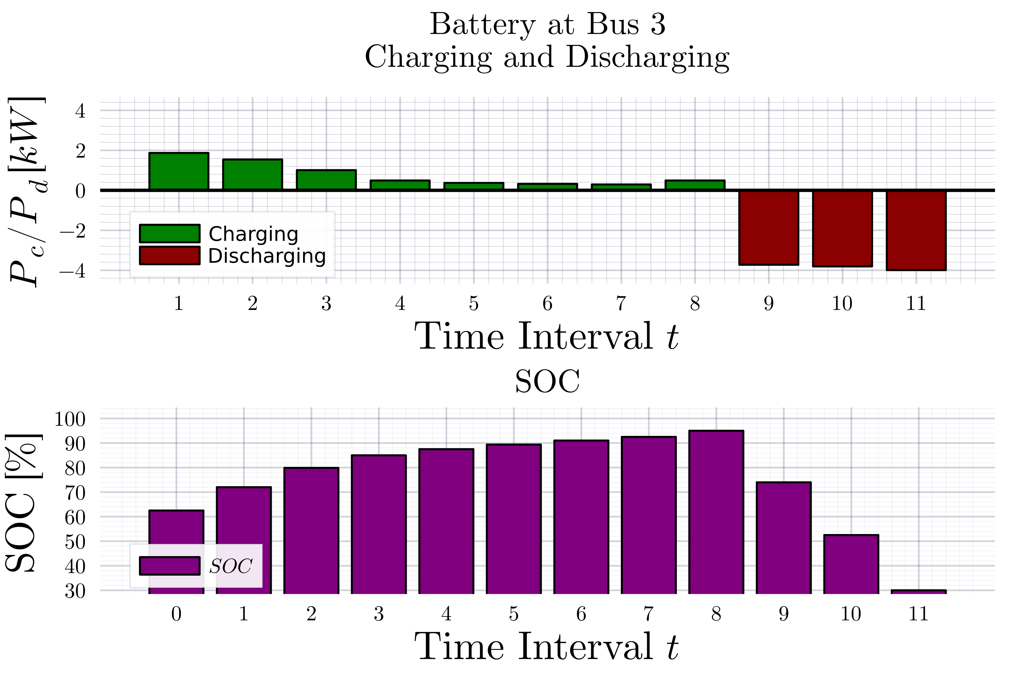
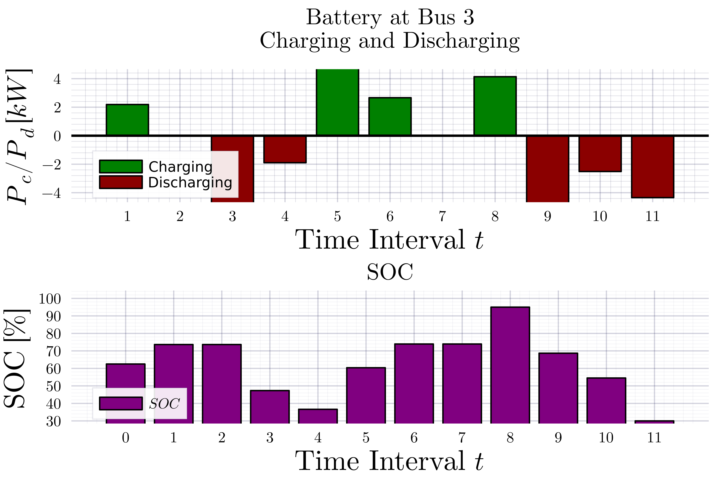
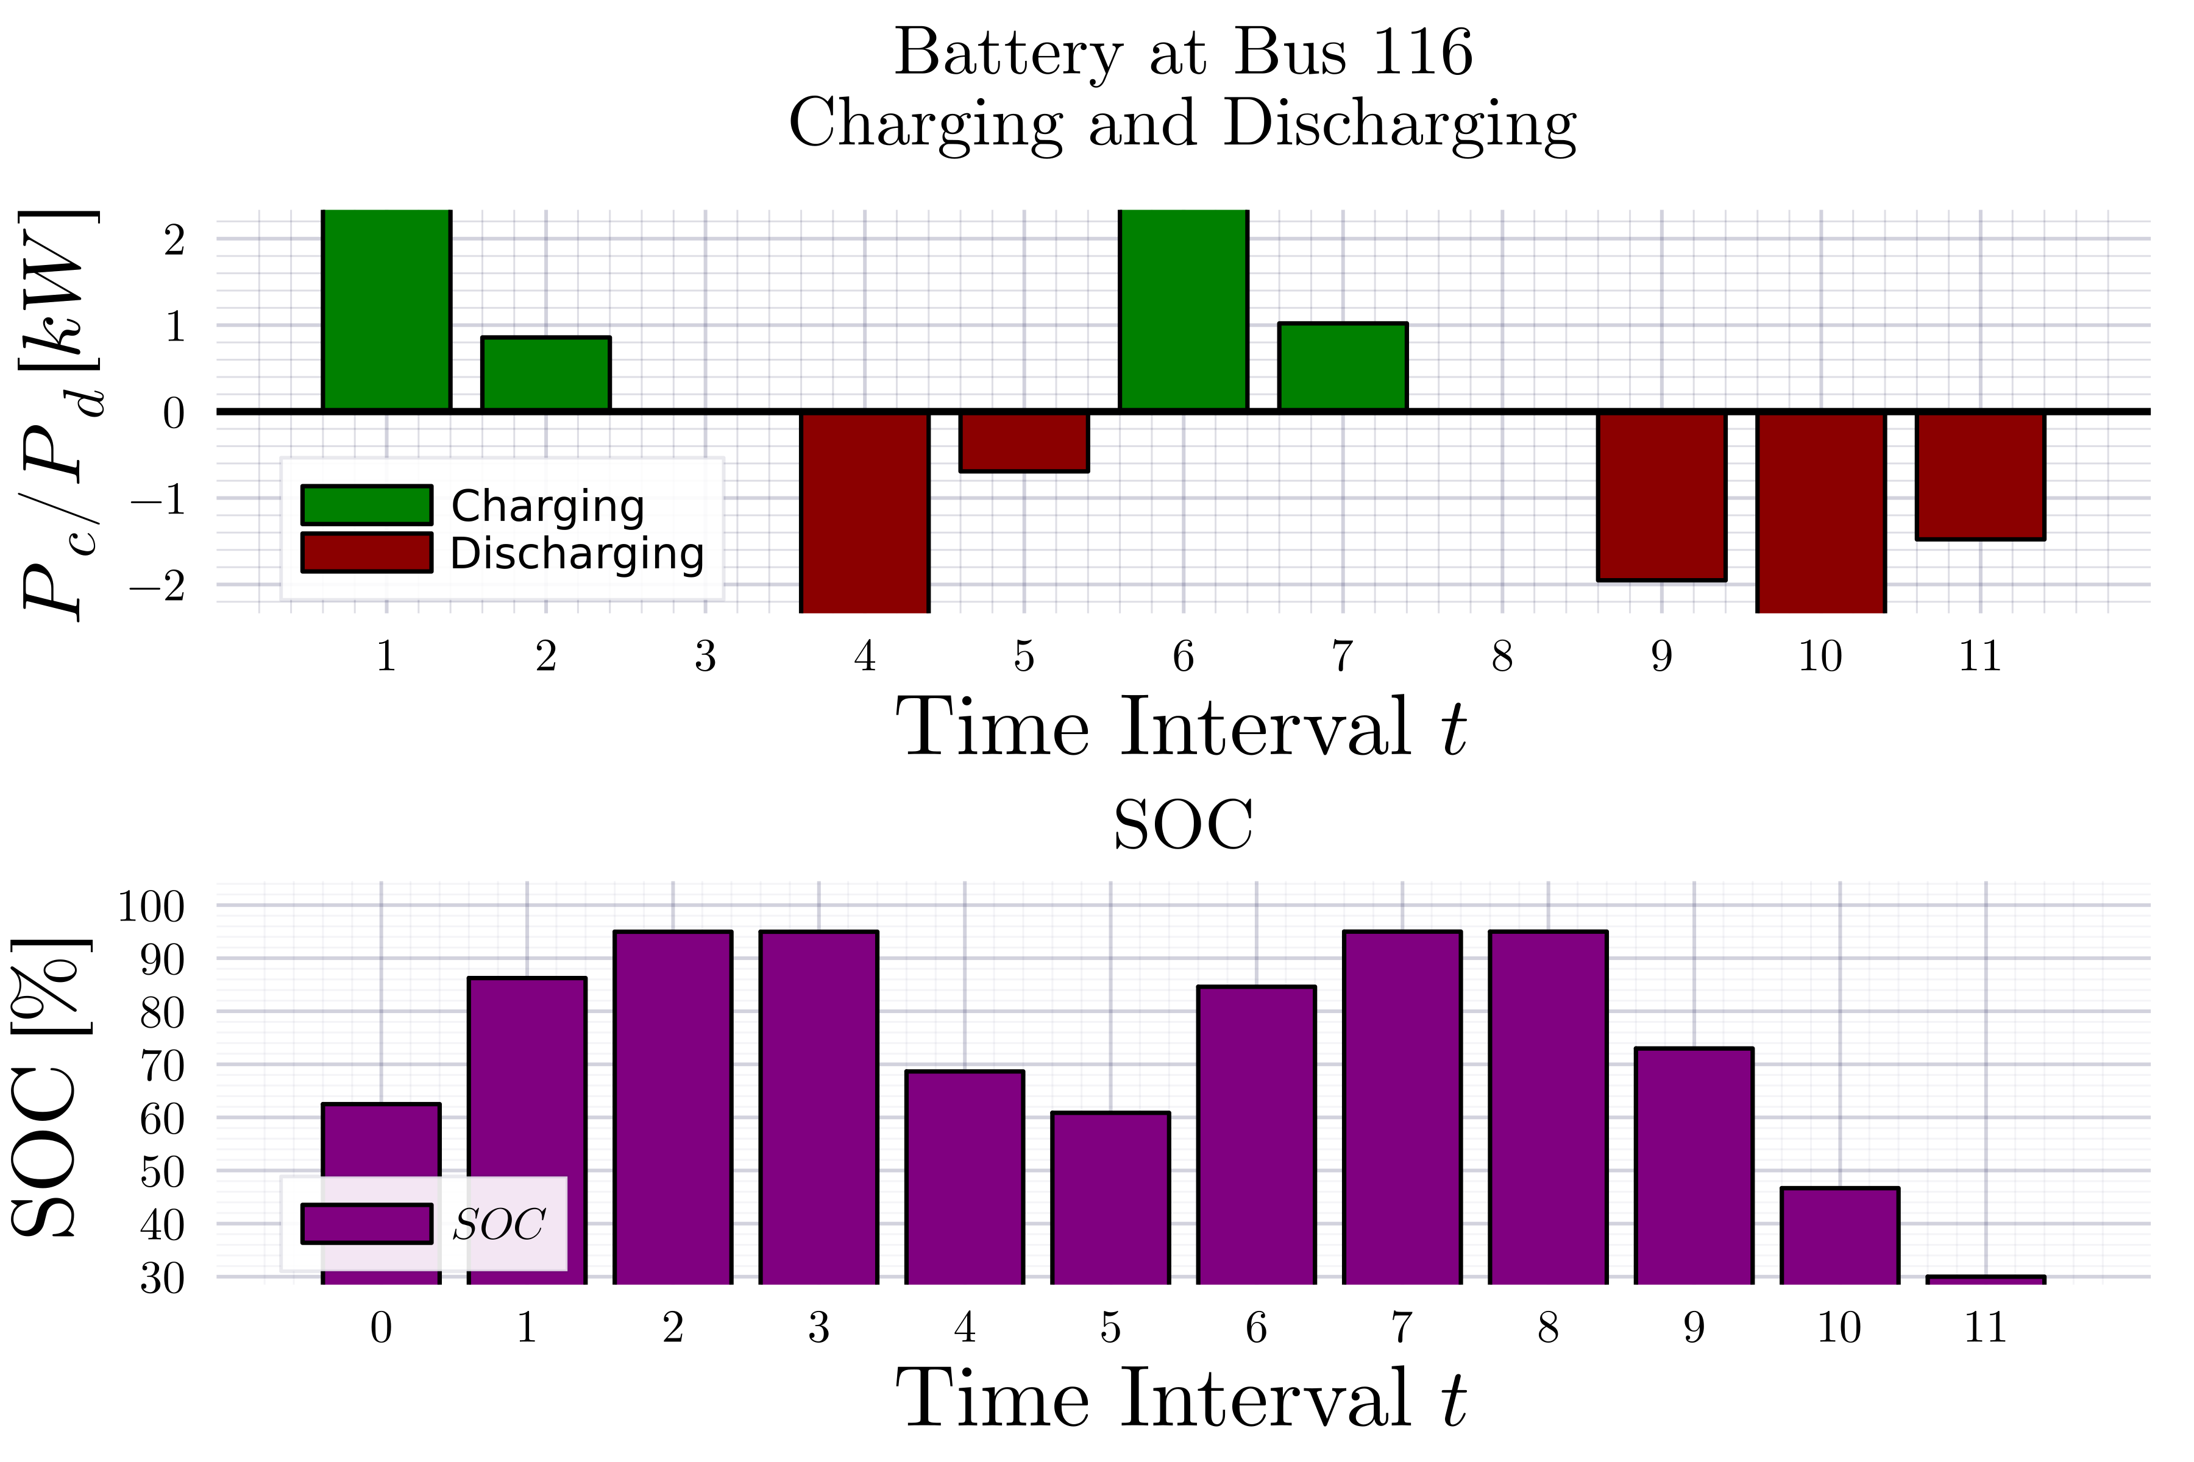
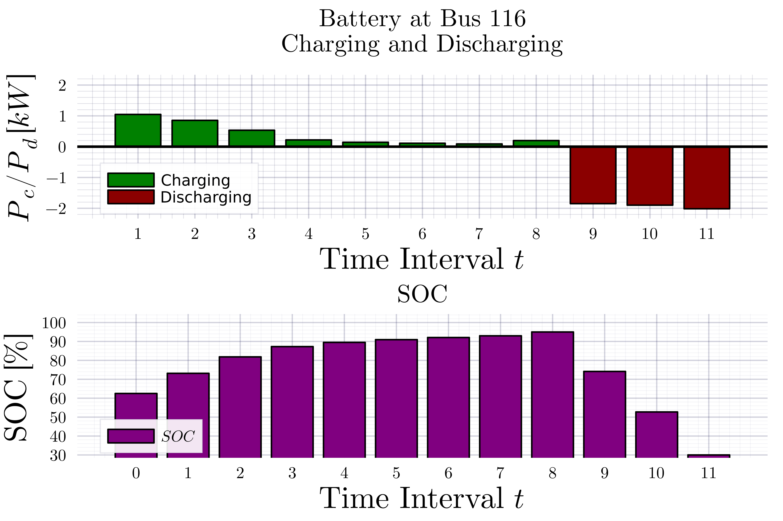
Decision Variables Comparison Terminal SOC Constraint Relaxed
$$IEEE{123}_{1ph}, T=12$$
BruteForced (BF)
$$DDP$$

Slide 14
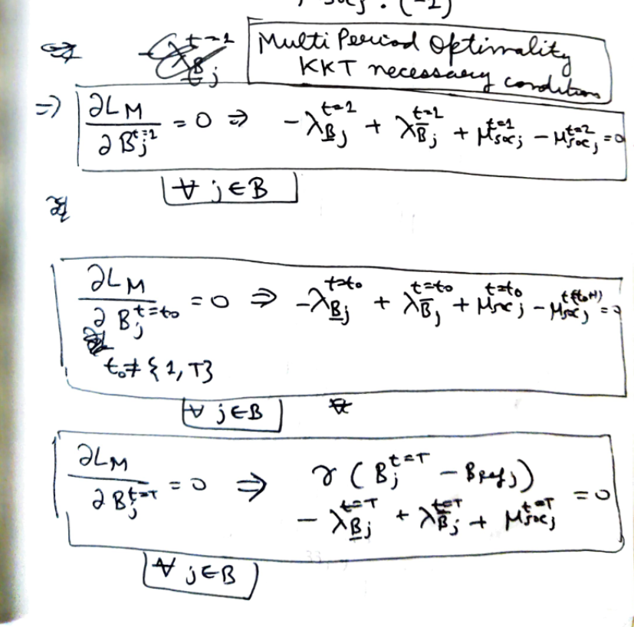

Multi Period Optimality KKT Necessary Conditions
For a ‘solution’ to be even considered to be MP-optimal, it must meet this mathematical condition.
[NOT dependent on the optimization method.]
Note: All following results are for the terminal SOC constraint relaxed condition. This will be the case until DDP is corrected.
Not present if terminal SOC condition relaxed $(γ=0)$

Slide 15




Dual Variables Comparison Terminal SOC Constraint Relaxed
$$ADS{10}_{1ph}, T=12$$
Note: Barely any difference between batteries (So results for only 1 battery given here, wlog)
BruteForced (BF)
SOC hits Upper Limit
SOC hits Lower Limit
KKT Necessary Conditions for Multi Period Optimality Hold!

Slide 16





Dual Variables Comparison Terminal SOC Constraint Relaxed
$$ADS{10}_{1ph}, T=12$$
Note: Barely any difference between batteries (So results for only 1 battery given here, wlog)
$$DDP$$
SOC hits Lower Limit (and stays there)
KKT Necessary Conditions for Multi Period Optimality Violated!
KKT Conditions for $t=T$ is implicitly taken care of.

Slide 17




Dual Variables Comparison Terminal SOC Constraint Relaxed
$$IEEE{123}_{1ph}, T=12$$
Note: Barely any difference between batteries (So results for only 1 battery given here, wlog)
BruteForced (BF)
SOC hits Upper Limit
SOC hits Lower Limit
KKT Necessary Conditions for Multi Period Optimality Hold!

Slide 18




Dual Variables Comparison Terminal SOC Constraint Relaxed
$$IEEE{123}_{1ph}, T=12$$
Note: Barely any difference between batteries (So results for only 1 battery given here, wlog)
$$DDP$$
SOC hits Lower Limit (and stays there)
KKT Necessary Conditions for Multi Period Optimality Violated!
KKT Conditions for $t=T$ is implicitly taken care of.

Slide 19












Dual Variables Comparison Terminal SOC Constraint Relaxed
$$IEEE{123}_{1ph}, T=24$$
$$IEEE{123}_{1ph}, T=3$$
$$DDP$$
BruteForced (BF)
$$DDP$$
BruteForced (BF)
DDP $μ$ value for $t=1$ is weirdly positive (similar magnitude as other timesteps), even though every other $μ$ in the horizon in DDP as well as every $μ$ in BF are all negative.
Note: It itself is not used in DDP workflow.
All batteries: $μ$ values for all batteries for any particular time step $t_{0}$ are pretty much the same, and strongly correlated with the Substation Power Cost $(\$/kWh)$

Slide 20







Dual Variables Comparison Terminal SOC Constraint Relaxed
$$ADS{10}_{1ph}, T=24$$
$$ADS{10}_{1ph}, T=3$$
$$DDP$$
BruteForced (BF)
$$DDP$$
BruteForced (BF)
DDP $μ$ value for $t=1$ is weirdly positive (similar magnitude as other timesteps), even though every other $μ$ in the horizon in DDP as well as every $μ$ in BF are all negative.
Note: It itself is not used in DDP workflow.
All batteries: $μ$ values for all batteries for any particular time step $t_{0}$ are pretty much the same, and strongly correlated with the Substation Power Cost $(\$/kWh)$

Slide 21




Dual Variables Comparison Terminal SOC Constraint Enforced
$$IEEE{123}_{1ph}, T=24$$
$$IEEE{123}_{1ph}, T=3$$
$$DDP$$
BruteForced (BF)
$$DDP$$
BruteForced (BF)
DDP $μ$ value for $t=1$ is weirdly positive (similar magnitude as other timesteps), even though every other $μ$ in the horizon in DDP as well as every $μ$ in BF are all negative.
Note: It itself is not used in DDP workflow.
All batteries: $μ$ values for all batteries for any particular time step $t_{0}$ are pretty much the same, and strongly correlated with the Substation Power Cost $(\$/kWh)$

Slide 22

Dual Variables Comparison Terminal SOC Constraint Enforced
$$ADS{10}_{1ph}, T=24$$
$$ADS{10}_{1ph}, T=3$$
$$DDP$$
BruteForced (BF)
$$DDP$$
BruteForced (BF)
DDP $μ$ value for $t=1$ is weirdly positive (similar magnitude as other timesteps), even though every other $μ$ in the horizon in DDP as well as every $μ$ in BF are all negative.
Note: It itself is not used in DDP workflow.
All batteries: $μ$ values for all batteries for any particular time step $t_{0}$ are pretty much the same, and strongly correlated with the Substation Power Cost $(\$/kWh)$

Slide 23






DDP Codebase Workflow
$$1$$
$$2$$
Parser
$$3$$
Optimizer
Post-processing and Validation

Slide 24

DDP Codebase Workflow
Model Building
Model Solving

Slide 25


DDP Codebase Workflow
Model Building
Model Solving

Slide 26


DDP Codebase Workflow
Model Copied from $k=1, t=1$
Model Altered as per this iteration:
Objective function of model updated with latest available Model Solving

Slide 27










IEEE$123$_$1$ph: MPCOPF Run for $T=24, PV=20\%, Batt=30\%$
OpenDSS Def Profiles
Substation Power Cost
$P_{Subs}^{t}$
$P_{SubsCost}^{t}$
$$P_{Loss}^{t}$$
MPCOPF Simulation Results
OpenDSS Powerflow Results
Objective
Objective
Miscomputation - will be fixed later
$$P_{SubsPeak}$$
Discrepancies
Timings

Slide 28



IEEE$123$_$1$ph: MPCOPF Run for $T=24, PV=20\%, Batt=30\%$
OpenDSS Def Profiles
Substation Power Cost

Slide 29




IEEE$123$_$1$ph: MPCOPF Run for $T=24, PV=20\%, Batt=30\%$
OpenDSS Def Profiles
Substation Power Cost
Minor difference between solver optimal decision variables
IpOpt
Juniper

Slide 30


Three Steps for Optimization Implementation (and what will be different for DDP):
[No change] Loading Simulation Configuration from OpenDSS (.dss) files, Pre-optimization housekeeping
[Some change] Optimization Routine (Temporally brute forced optimization now verified, can be used as ‘Benchmark’ result for checking Optimality Gap)
[No change] Post Optimization result validation via OpenDSSDirect
Now onto writing the script for DDP optimization routine ..
Initial Test System: ADS$10$_$1$ph with $8$ Loads, $2$ PVs and $2$ Batteries

Slide 31




IEEE$123$_$1$ph: MPCOPF Run for $T=12, PV=20\%, Batt=30\%$
OpenDSS Def Profiles
Substation Power Cost
$P_{Subs}^{t}$
$P_{SubsCost}^{t}$
$$P_{Loss}^{t}$$
MPCOPF Simulation Results
OpenDSS Powerflow Results
Objective
Objective
Miscomputation - will be fixed later
$$P_{SubsPeak}$$
Weirdly high discrepancy in voltage (will be investigated)
Discrepancies
Timings

Slide 32


IEEE$123$_$1$ph: MPCOPF Run for $T=12, PV=20\%, Batt=30\%$
OpenDSS Def Profiles
Substation Power Cost

Slide 33






ADS$10$_$1$ph: MPCOPF Run for $T=24, PV=25\%, Batt=25\%$
OpenDSS Def Profiles
Substation Power Cost
$P_{Subs}^{t}$
$P_{SubsCost}^{t}$
$$P_{Loss}^{t}$$
MPCOPF Simulation Results
OpenDSS Powerflow Results
Objective
Objective
Miscomputation - will be fixed later
$$P_{SubsPeak}$$
Discrepancies
Timings

Slide 34


ADS$10$_$1$ph: MPCOPF Run for $T=24, PV=25\%, Batt=25\%$
OpenDSS Def Profiles
Substation Power Cost

Slide 35



DDP for MPOPF for ADS Workflow

Slide 36
DDP for MPOPF for ADS Workflow

Slide 37
Steps towards understanding Temporal Decomposition – Which Papers to Read?
Find work where it has actually been used.
Beginning with only those which solve for the MPOPF problem.
Right now, Transmission systems are OK too (they have to deal with ramping up/down constraints for generators)
But may look into other domains as well afterwards
Ascertaining which approach to follow, based on certain desirable features the future algorithm should have.

Slide 38

Steps towards understanding Temporal Decomposition – Intended Algorithmic Solution
Desirable features the future algorithm should have:
Should be scalable with respect to Time (horizon duration)
At least, something like $96$ time-steps should be solvable in one go
Should ideally solve for the ‘true’ nonlinear problem, with as few approximations as possible
Relaxations however are fine, and if they’re used, their solutions will obviously be checked for any infeasibility.
Changing optimization formulation is undesirable for me. Something close to, if not exactly the same as the ‘standard’ nonlinear Branch Flow Model [farivar2013] is what I want.
So, I’m looking to solve the problem using Branch Flow Variables $P_{ij}, Q_{ij}, v_{j}, l_{ij}$ only.
Many papers, bring out their own new set of variables, approximations, customized algorithms to deal with them, in order to solve for the MPOPF problem. This is NOT what I’m looking to do.

Slide 39
Do others ‘scalably’ solve MPOPF? – Some of them, Yes.
These days, many papers pose a solution to the MPOPF problem.
Many papers don't actually solve the problem in a scalable manner: the test-cases are reasonable (moderate sized, moderate penetration, day-ahead or large sized, low penetration, some hours only), but even they acknowledge that this formulation is not scalable, unless ...
… Approximations are made

Slide 40


How do others ‘scalably’ solve it? – Linearized Solution, Iteratively Improved
Specifically,
… Approximations are made at the most modular form of OPF formulation [usman2022, usman2023] which itself could be within a loop, where some meta-parameters are adjusted based on successive iterative updates.
Some papers model these successive iterative updates on a homotopy based paradigm [agarwal2022]
MILP call inside a bigger algorithm
Some homotopy thing

Slide 41


How do others ‘scalably’ solve it? – Hierarchical Optimization, Approximated (Relaxed) Top Level Step
Specifically,
The full optimization problem is divided into hierarchies, with the top hierarchy problem solving for an approximate (relaxed) model of the full horizon MINLP (NLP) problem.
Once the top-level problem is solved and set-points for temporally-coupling decision variables are obtained, the same decision variables are kept as constant for every single time-step’s OPF formulation.
The now temporally-decoupled Single-Period Optimal Power Flow Problems are formulated as SOCP (NLP) in a parallel manner.
[nazir2018 (nazir2020)]
Inner SOCP call within an outer MILP loop
Inner NLP call within an outer SOCP loop

Slide 42



How do others ‘scalably’ solve it? – Some sort of Algorithms involving Primal Dual Decomposition of the Constraints containing Variables from different time-steps
Generator Ramping Constraints
Not fully appreciated (understood) by me yet. But here are two instances:
In [agarwal2022] Their transmission system has many kinds of constraints, but only two temporally coupling constraints – Generator Ramping (one upper bound inequality and one lower bound inequality for each generator for each ‘time-boundary’) and Battery SOC (one equality for each battery for each time-boundary). All other equality/inequality constraints are constraints within a particular time-step, and thus are also called as uncoupled constraints.
They then formulate a Lagrangian Function for the full OPF problem. After grouping ‘like’ terms together (as in whether they are temporally coupled or uncoupled), they ended up with this equation, which has (a summation of) temporally coupled terms (which come arise from the three kinds of temporal constraints) and temporally uncoupled terms (all contained in the first term)
Finally, from the full horizon problem, a $t$-th time-step problem function is carved out, which, outside the variables for that time-step, only contains certain primal and dual variables outside the time-step, including:
$P_{G}^{t−Δt}, B^{t−Δt}, μ_{P_{ramp}}^{t+Δt}$ (both lower and upper bounds), $λ_{B}^{t+Δt}$
Battery SOC Constraint
Lagrangian Function representing the full MPOPF problem (all time-steps)
Lagrangian Function representing the OPF problem for the $t$-th time-step. Notice that the ‘new’ blocks are just terms from the ‘existing’ blocks but coming from the adjacent time-steps to $t:\{t−Δt, t+Δt\}$

Slide 43


How do others ‘scalably’ solve it? – Some sort of Algorithms involving Primal Dual Decomposition of the Constraints containing Variables from different time-steps
Finally, from the full horizon problem, a $t$-th time-step problem function is carved out, which, outside the variables for that time-step, only contains certain primal and dual variables outside the time-step, including:
Past Primal Variables: $P_{G}^{t−Δt}, B^{t−Δt}$
Future Dual Variables: $μ_{P_{ramp}}^{t+Δt}$ (both lower and upper bounds), $λ_{B}^{t+Δt}$
While the problem itself cannot be solved for without knowing both past and future variables, as part of their Differential Dynamic Programming (DDP) Paradigm, they do a Forwards Pass and a Backwards Pass, wherein in each pass, they assume one set of variables to be constant (initially guessed, or possibly known from a previous computation).
Lagrangian Function representing the OPF problem for the $t$-th time-step.

Slide 44


How do others ‘scalably’ solve it? – Some sort of Algorithms involving Primal Dual Decomposition of the Constraints containing Variables from different time-steps
Past Primal Variables: $P_{G}^{t−Δt}, B^{t−Δt}$
Future Dual Variables: $μ_{P_{ramp}}^{t+Δt}$ (both lower and upper bounds), $λ_{B}^{t+Δt}$
Specifically, in Forward Pass, they use the solved-for values of the past primal variables i.e. from the $t−Δt$-th step as knowns for the problem at the $t$-th step, and assume the last-known/initially-guessed values of the dual variables from the future i.e. from the $t+Δt$-th step as constants, in order to fully solve the problem at the $t$-th step.
Once the values of the primal variables values for the $t$-th step is known, they proceed one step forward, this time using those as the values of the past primal variables, again assuming the future dual variables as some constants.
This forward pass process continues till the end-of-horizon (last time-step, let’s call it $T$).
Lagrangian Function representing the OPF problem for the $t$-th time-step.
Scheme for Forward Pass and Backward Pass (here called ‘Sweep’ with no difference)

Slide 45



How do others ‘scalably’ solve it? – Some sort of Algorithms involving Primal Dual Decomposition of the Constraints containing Variables from different time-steps
Past Primal Variables: $P_{G}^{t−Δt}, B^{t−Δt}$
Future Dual Variables: $μ_{P_{ramp}}^{t+Δt}$ (both lower and upper bounds), $λ_{B}^{t+Δt}$
Once a forward pass is completed, i.e. the cost of the forward trajectory is constructed. It is time to solve for the gradients that will update the dual variables for the next forward pass.
Thus after computation of these gradients, the next set of dual variables $μ_{P_{ramp}}^{t+Δt},λ_{B}^{t+Δt}$ is computed.
The process of Forward Pass and Backward Pass updates is carried on until convergence is achieved (updates no longer being significant).
Lagrangian Function representing the OPF problem for the $t$-th time-step.
Scheme for Forward Pass and Backward Pass (here called ‘Sweep’ with no difference)
Equations used for updating the future dual variables as part of the Backward Pass

Slide 46

How do others ‘scalably’ solve it? – Some sort of Algorithms involving Primal Dual Decomposition of the Constraints containing Variables from different time-steps
Thus after computation of these gradients, the next set of dual variables $μ_{P_{ramp}}^{t+Δt},λ_{B}^{t+Δt}$ is computed.
The process of Forward Pass and Backward Pass updates is carried on until convergence is achieved (updates no longer being significant).
Lagrangian Function representing the OPF problem for the $t$-th time-step.
Done: I’ve understood the overall structure of a DDP implementation. Specifically, I’ve understood what is known, what is solved for, and what is assumed constant within a single time-period’s OPF. I understand the ‘Forward Pass’ component.
Current: I’m still studying the derivation required to understand the ‘Backward-Pass’ (how to use the gradient of the Lagrangian to get the dual variable updates). Once that is understood, I’ll have the understanding of one way to temporally decouple MPOPF for my use-case (ADS) as well, in a manner which can be implemented in code.
Scheme for Forward Pass and Backward Pass (here called ‘Sweep’ with no difference)
Equations used for updating the future dual variables as part of the Backward Pass

Slide 47
How do others ‘scalably’ solve it? – Some sort of Algorithms involving Primal Dual Decomposition of the Constraints containing Variables from different time-steps
A paper utilizing ADMM for temporal decomposition: [pinto2020]
Deficiencies:
I don’t understand how ADMM works, because I don’t understand how dual variables work.
To have a good understanding of dual variables, I have been reading up on theory [wolf2011]. I’ve gained some confidence in it but am yet to understand certain other key concepts thoroughly.
The plan is to understand dual variables [wolf2011]., understand ADMM, understand ADMM usage in OPF [peng2015] , ultimately understand ADMM in MPOPF [pinto2020]
.

